Slide 1
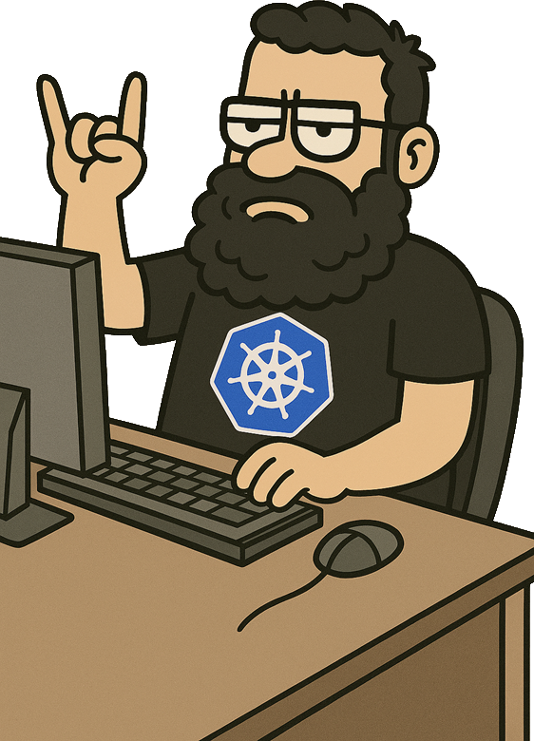
Nutanix Kubernetes Platform Design, Best practices and Sizing
Notes:
Super session 1h30

Slide 2


Gautier Leblanc
Christophe Jauffret
Portfolio Products Specialist, Cloud Native
Principal Architect, Cloud Native
Nutanix
Nutanix

Slide 3



Agenda
Best practices
Focus on important day 2 operations
Design & install
Sizing Guidance
How to deploy NKP, regarding my environment
How to size NKP clusters

Slide 4
Design & install

Slide 5


Design

Slide 6
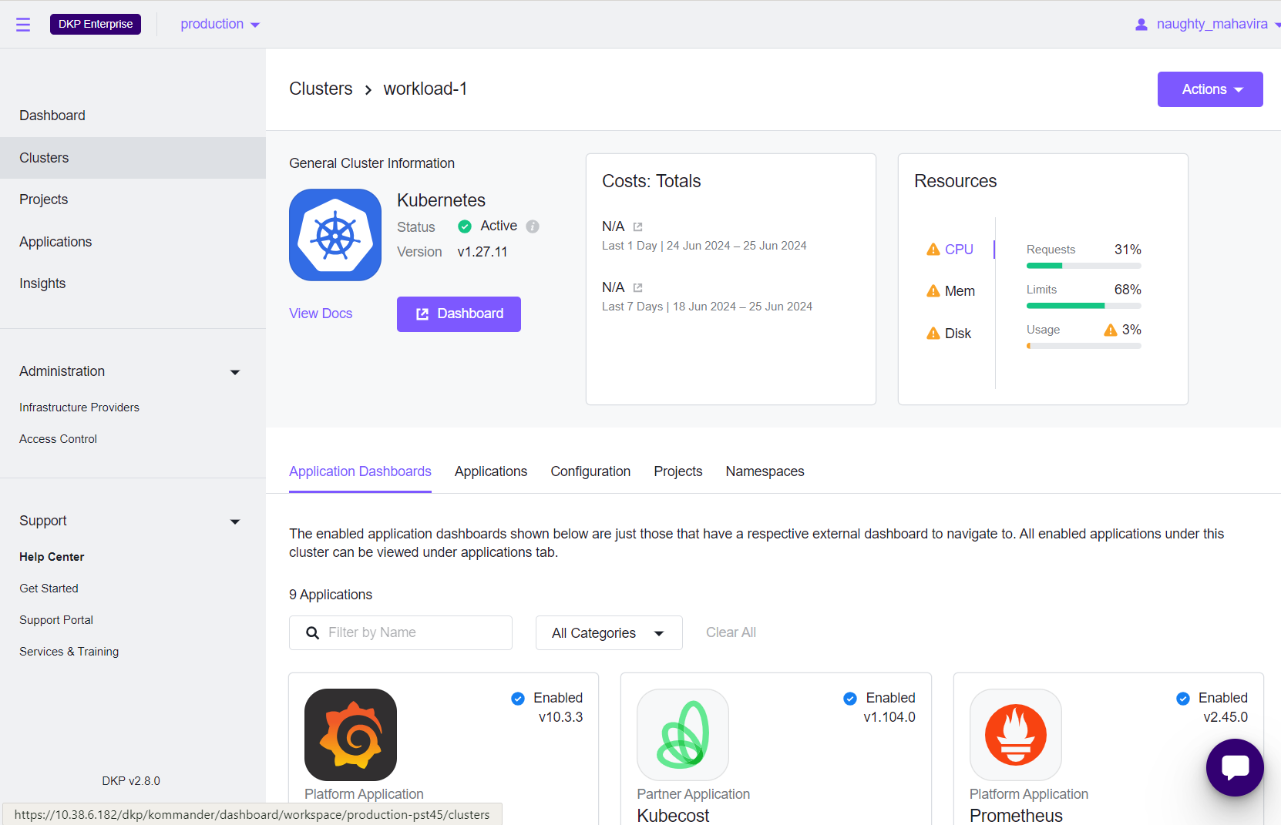
Management, workload and self-managed clusters
Management + workload/managed clusters
Self-Managed cluster
(Management + workload together)
CP
CP
CP
W
W
W
Management plane
CP
CP
CP
Management cluster takes care of workload ones
W
W
W
Management plane
W
W
Customer Workloads
CP
CP
CP
CP
CP
CP
W
W
W
W
W
W
Customer Workloads
W
W
W

Slide 7

Which architecture, when ?
?
DataCenter
1 workload cluster : Self-managed
Multiple managed clusters : Classic deployment
Edge
1 management cluster in a regional site
X managed clusters on remote sites
Edge with almost no network
1 self-managed cluster
Notes:
Mettre ici un ensemble de use-case avec le déploiement préférable
1 cluster k8s : Self-Managed
DC : Management + Workload
Edge : Management central + workloads

Slide 8

High availability
>2 Datacenters
>3 Datacenters
New 2.16
Site A
Site B
Site A
Site B
Site C
Management cluster
Management cluster
Workload cluster
Workload cluster A
Workload cluster B
Support 2 sites
Simpler to deploy
Independant K8s clusters
Management on a unique site
Apps management is harder
Classic storage management
Need at least 3 sites
Harder to deploy (Advanced install)
Any cluster failure breaks everything
Management more resilient
Easiest way do deploy stateless apps
Storage management is more tricky
Notes:
2 DC : 2 clusters + replication
3 DC :
1 cluster spread
3 clusters et appli partagées
Mettre avantages et inconvénients de chaque solution

Slide 9

Clusters network flows
Image access
Registry
PC API
PC API
iSCSI
Management cluster
Control plane
Image access
PC
Overlay comm
MetalLB
Calico metrics / Typha
Cilium mTLS / Hubble
Kubelet API
Workers
Proxy UI
Kube API Server
Dex
PC API
Kube API Server
Workload cluster
PC API
iSCSI
Control plane
Bastion
Overlay comm
MetalLB
Kubelet API
Calico metrics / Typha
Cilium mTLS / Hubble
Workers
https://portal.nutanix.com/page/documents/ports-and-protocols?productType=Nutanix%20Kubernetes%20Platform

Slide 10


Powered by Cluster API (CAPI)
Cluster API simplifies provisioning and operating Kubernetes clusters
Manage the lifecycle (create, scale, upgrade, destroy) of Kubernetes clusters
Remediate to any drift
The same API works in different environments, both on-premises and in the cloud
Save thousands (tens of thousands) of lines of custom automation
NKP CLI create mgmt. cluster
Platform
Engineer
Management
Cluster
CAPI
Workload
Cluster
Workload
Cluster
Workload
Cluster
Notes:
Cluster API is a game-changer for organizations looking to simplify and standardize Kubernetes cluster management. Cluster API is a Kubernetes subproject that provides a standardized way to manage the lifecycle of Kubernetes clusters. It's a powerful tool that abstracts the complexities of infrastructure management, allowing users to leverage Kubernetes-style APIs to handle cluster operations.
Cluster API automates the full lifecycle of Kubernetes clusters, including creation, scaling, upgrading, and destruction. This means customers can easily scale their clusters up or down based on demand, perform rolling upgrades with minimal downtime, and tear down clusters when they are no longer needed. It simplifies the operational burden, allowing teams to focus more on their applications rather than managing the underlying infrastructure manually.
One of the major benefits of Cluster API is its ability to provide a consistent API across multiple environments, whether on-premises (AHV, ESXi) or in public clouds like AWS, Azure, or Google Cloud. This uniformity allows customers to adopt a hybrid or multi-cloud strategy without the need to learn different tools or processes for each environment. It ensures that operations teams have a single pane of glass for cluster management, greatly reducing complexity and training requirements.
Traditionally, managing clusters across diverse environments required custom scripts and automation, leading to maintenance challenges and potential inconsistencies. Cluster API eliminates the need for these custom scripts by providing out-of-the-box capabilities to manage clusters. This not only saves thousands or even tens of thousands of lines of custom automation code but also reduces the risk of errors and improves overall reliability.

Slide 11
Everything is custom resources
All the management cluster data are stored as custom resources in Kubernetes, starting with managed clusters definitions.
Main custom resources you’ll find:
Clusters
Machines

Slide 12

Install

Slide 13
NKP Management cluster install workflow
Bootstrap cluster creation
CAPI Components install
NKP Components install
NKP creates a k8s bootstrap in docker (uses kind)
Creates kubeconfig file for this cluster
NKP installs Cluster API engine in the final cluster
NKP deploys all the extra NKP éléments (GUI, metalLB, Traefik, App catalog, etc.)
CAPI Components install
CAPI Config move
NKP installs Cluster API engine in the bootstrap cluster, and configure it with Prism Central infos
NKP moves CAPI resources from bootstrap cluster to final one
Final cluster creation
Bootstrap cluster destroy
NKP uses CAPI from bootstrap cluster to create final cluster.
Creates kubeconfig file for this cluster
NKP destyroys bootstrap cluster

Slide 14
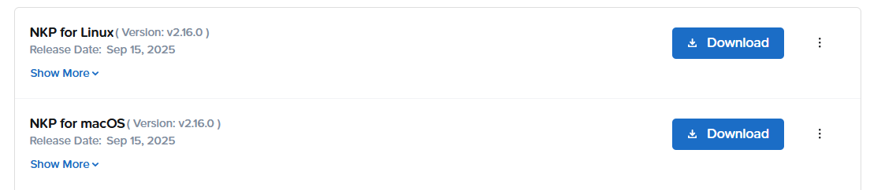
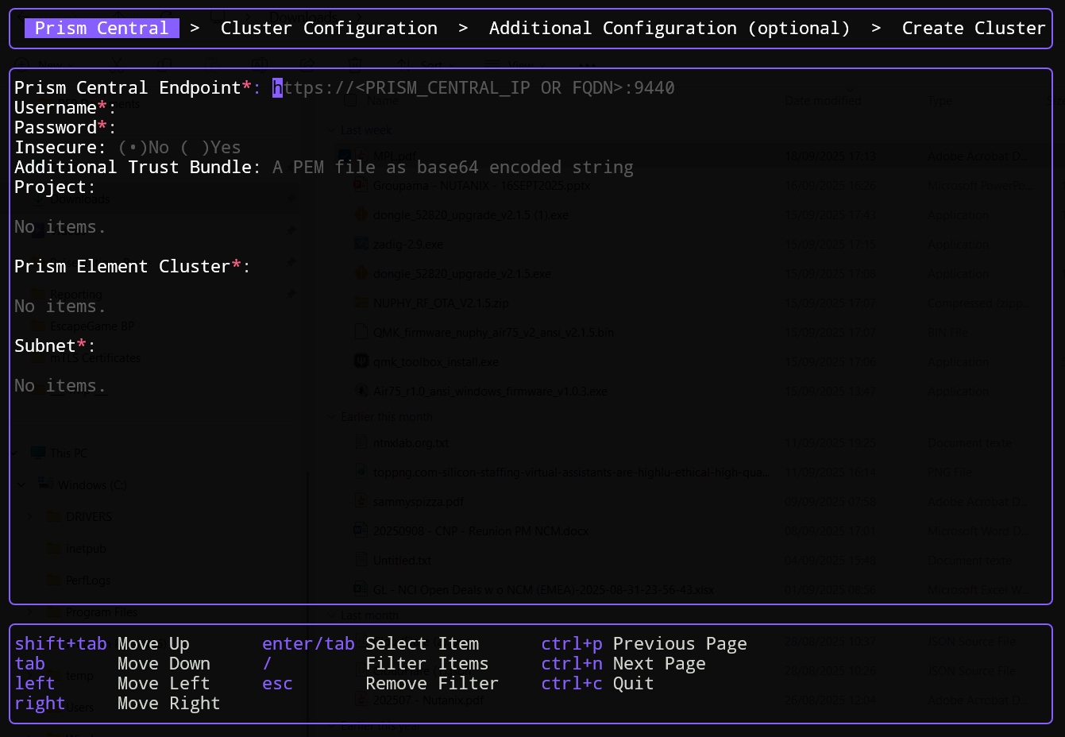
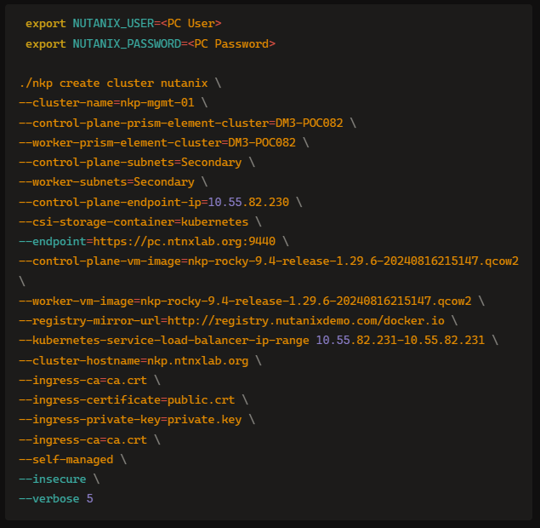
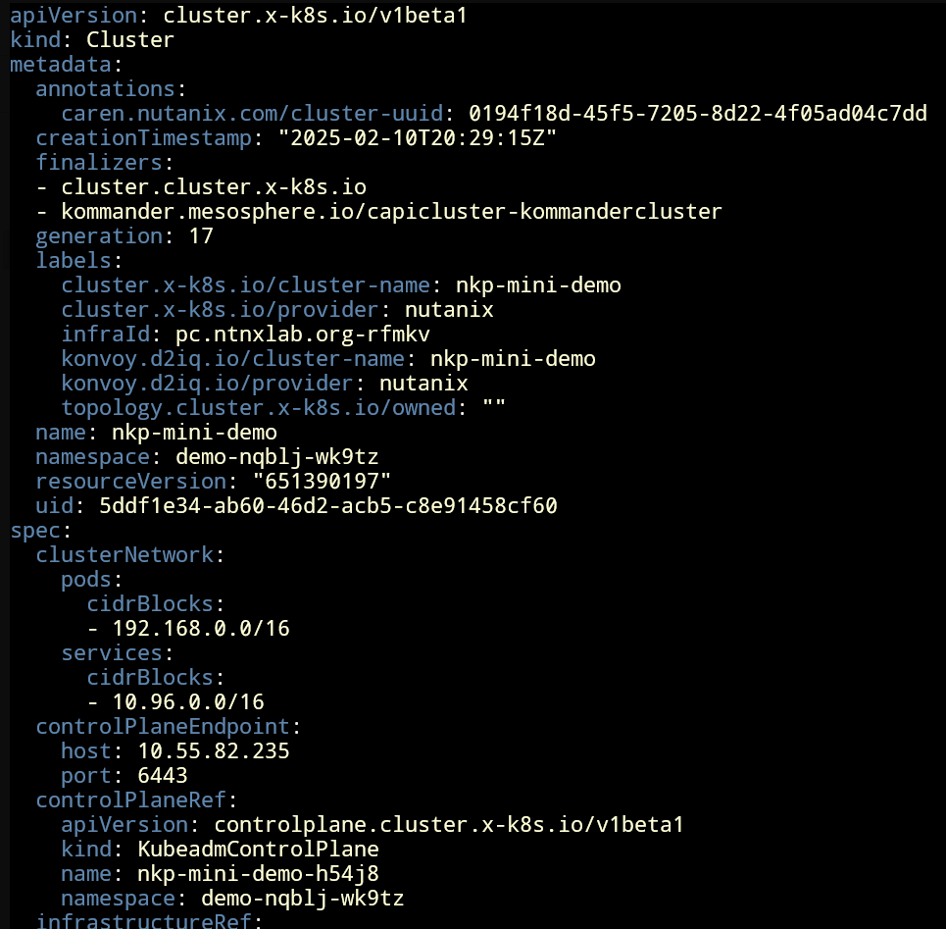
3 install methods
First, download nkp binary from the Nutanix portal.
Then…
TUI
CLI
Advanced
Ease of use but may be limited for customization
Strong command line to deploy a cluster. Will fit with most of the customers needs
CLI + Extra steps to push advanced configuration not doable with other methods
./nkp create cluster nutanix
Notes:
1 slide pour chaque partie importante
portante

Slide 15


Prepare your install
What will you need ?
Prism Central URL and account
Prism Element clusters names
Subnets info
Administrative k8s cluster name
Hostname for your k8s cluster
IP for your k8s cluster
VM image on your NTNX cluster
IP Ranges for pod and services
IP range for load-balancer
Storage container name
Certificates
Info about your registries
Proxies info
Method does not matter here
Preparation will bring you to success
Avoid waste of time
Ensure a good implementation

Slide 16
Prism Central
TUI
CLI
Advanced
Prism Central URL (https://[ip|fqdn]:port)
Does PC have a certificate ?
Insecure possible but strongly discouraged
Prism Central account
Should be a service account with long term password
This info will be used from `NUTANIX_USER` and `NUTANIX_PASSWORD` environment variables for installation (optional for TUI)
--endpoint <URL>
--insecure
--additional-trust-bundle <base64 cert bundle>
Export these env vars :
NUTANIX_USER
NUTANIX_PASSWORD
Mandatory
Optional

Slide 17
Prism Elements
TUI*
CLI
Advanced
* Supports only 1 PE for all pools
You’ll have to provide Nutanix physical clusters names to target where nodes will be deployed.
CP and Workers can use different clusters (except with TUI)
Use the name shown in PC
With NKP 2.16 and Failure Domain new feature, you can use 3 different PE to host the control plane
Only available with advanced install
--control-plane-prism-element-cluster <name>
--worker-prism-element-cluster <name>
TUI
CLI
Advanced
Mandatory
Optional

Slide 18
Subnets
TUI
CLI
Advanced
You’ll have to provide subnets for control-plane and workers
May be different for CP and workers
Need to already exist on your clusters
External IPAM / Nutanix IPAM supported
If External IPAM: DHCP needs to be available
Ensure you have free addresses outside of the dynamic pool (for API endpoint and MetalLB)
Ensure dynamic pool is large enough for all your k8s cluster nodes
--control-plane-subnets <names>
--worker-subnets <names>
WARNING : be careful, NKP installer is case sensitive
Mandatory
Optional

Slide 19
Cluster name
TUI
CLI
Advanced
This value is related to Cluster API.
The `cluster` custom resource will use this name
Will be used to prefix all cluster resources
Need to use lower-case and `-` symbol only
--cluster-name <name>
TUI
CLI
Advanced
Cluster hostname
The FQDN to reach your k8s cluster
Need to be preconfigured in your DNS
If not defined, you’ll use IP to reach the cluster
--cluster-hostname <FQDN>
Mandatory
Optional

Slide 20
Control plane endpoint IP
TUI
CLI
Advanced
Will be the IP to access to your Kubernetes cluster API
This VIP (using kube-vip) will be hosted by control plane nodes (one at a time)
Need to be in your control plane subnet address plan
Kubectl target
--control-plane-endpoint-ip <IP>
Mandatory
Optional

Slide 21
VM image
TUI
CLI
Advanced
Name of the image to use as OS for your nodes
Image may be different between node pools
Important : Image name must fetch specific regexp to be usable :
--control-plane-vm-image <name>
--worker-vm-image <image>
nkp-<OS name>-<OS version>-release-<Kubernetes version>-<timestamp>
Mandatory
Optional

Slide 22
IP ranges
TUI
CLI
Advanced
You’ll have to provide 3 IP ranges for the cluster install :
Pods IPs CIDR / Services IPs CIDR
Don’t use ranges overlapping customer ones
Use large ranges (/16+)
Be careful with default values
Can be reused in different k8s clusters
not recommended if you plan to mesh your clusters
Load-balancer IP range
Format : <First IP>-<Last IP>
Use same values to provide a unique IP
Need to be in your workers subnet address plan
--kubernetes-pod-network-cidr <CIDR>
--kubernetes-service-cidr <CIDR>
--kubernetes-service-load-balancer-ip-range <source>-<dest>
Mandatory
Optional

Slide 23
Storage
TUI
CLI
Advanced
On Nutanix install, NKP deploy CSI and configure a storage class
Available parameters are :
Nutanix storage container name
File system
Flash mode
Reclaim policy
Direct attached mode
--csi-file-system <ext4/xfs>
--csi-flash-mode <true/false>
--csi-hypervisor-attached-volume <true/false>
--csi-reclaim-policy <Delete/Retain>
--csi-storage-container <name>
Mandatory
Optional

Slide 24
Ingress certificates
TUI
CLI
Advanced
You can push your own certificate for the ingress entrypoint (Kommander UI)
Do not forget to renew it
ACME integration
Automate cert creation
Require HTTP challenge prerequisites
--ingress-certificate=<file>
--ingress-private-key=<file>
--ingress-ca=<file>
--acme-email <email>
--acme-server <URL>
--certificate-renew-interval <# days>
Mandatory
Optional
Notes:
ACME => only si serveur expose => challenge HTTP-01=> bad idea
--acme-email string Email address the ACME server can use to contact you.
--acme-server string

Slide 25
Mirror registry
TUI
CLI
Advanced
During install, you can define a mirror registry
All images pull will first use this alternative registry
If image is not found, the public registry will be used
--registry-mirror-url <url>
--registry-mirror-username <name>
--registry-mirror-password <string>
--registry-cacert <file>
--registry-mirror-cacert <file>
TUI
CLI
Advanced
Private registry
Specify accounts / certificate for your internal registry
--registry-password <string>
--registry-url <url>
--registry-username <string>
Mandatory
Optional

Slide 26
SSH
TUI
CLI
Advanced
You can pass a key at install time
Allow ssh access to the NKP nodes, mainly for troubleshooting purpose
Be careful about security impact (single key, rotation , revokation ….)
--ssh-username <name>
--ssh-public-key-file <file>
Mandatory
Optional

Slide 27
Proxies
TUI
CLI
Advanced
NKP install requires registries to get components for :
Bootstrap cluster
CAPI components
NKP components (kommander, apps)
You may need to provide proxies info to to connect to public or private registries
--http-proxy <proxies list>
--https-proxy <proxies list>
--no-proxy <list of target without proxy usage>
Mandatory
Optional

Slide 28
Self-managed
TUI*
CLI
Advanced
* forced
Request install of a kubernetes cluster with management part
Use it for :
Initial NKP install
Self-managed clusters install
--self-managed
Airgap context
TUI
CLI
Advanced
Won’t deploy ‘online services’ (ex chatbot)
Since NKP 2.16, « airgap first » mode is available (Detailed later)
--airgapped
--bundle
Mandatory
Optional

Slide 29
Troubleshooting the install
Verbose mode : --verbose <int>
Cluster API :
Look at custom resource description in the ‘active’ CAPI cluster (may be bootstrap or final one, depending install phase)
Check machine resources status first
Look at Cluster API pods logs to see what happens on the cluster. More interesting pods are :
capi-controller
capx (exchange Prism/capi)
cluster-api-runtime-extensions-Nutanix
kommander-bootstrap
kommander-operator

Slide 30
NKP Advanced installation

Slide 31
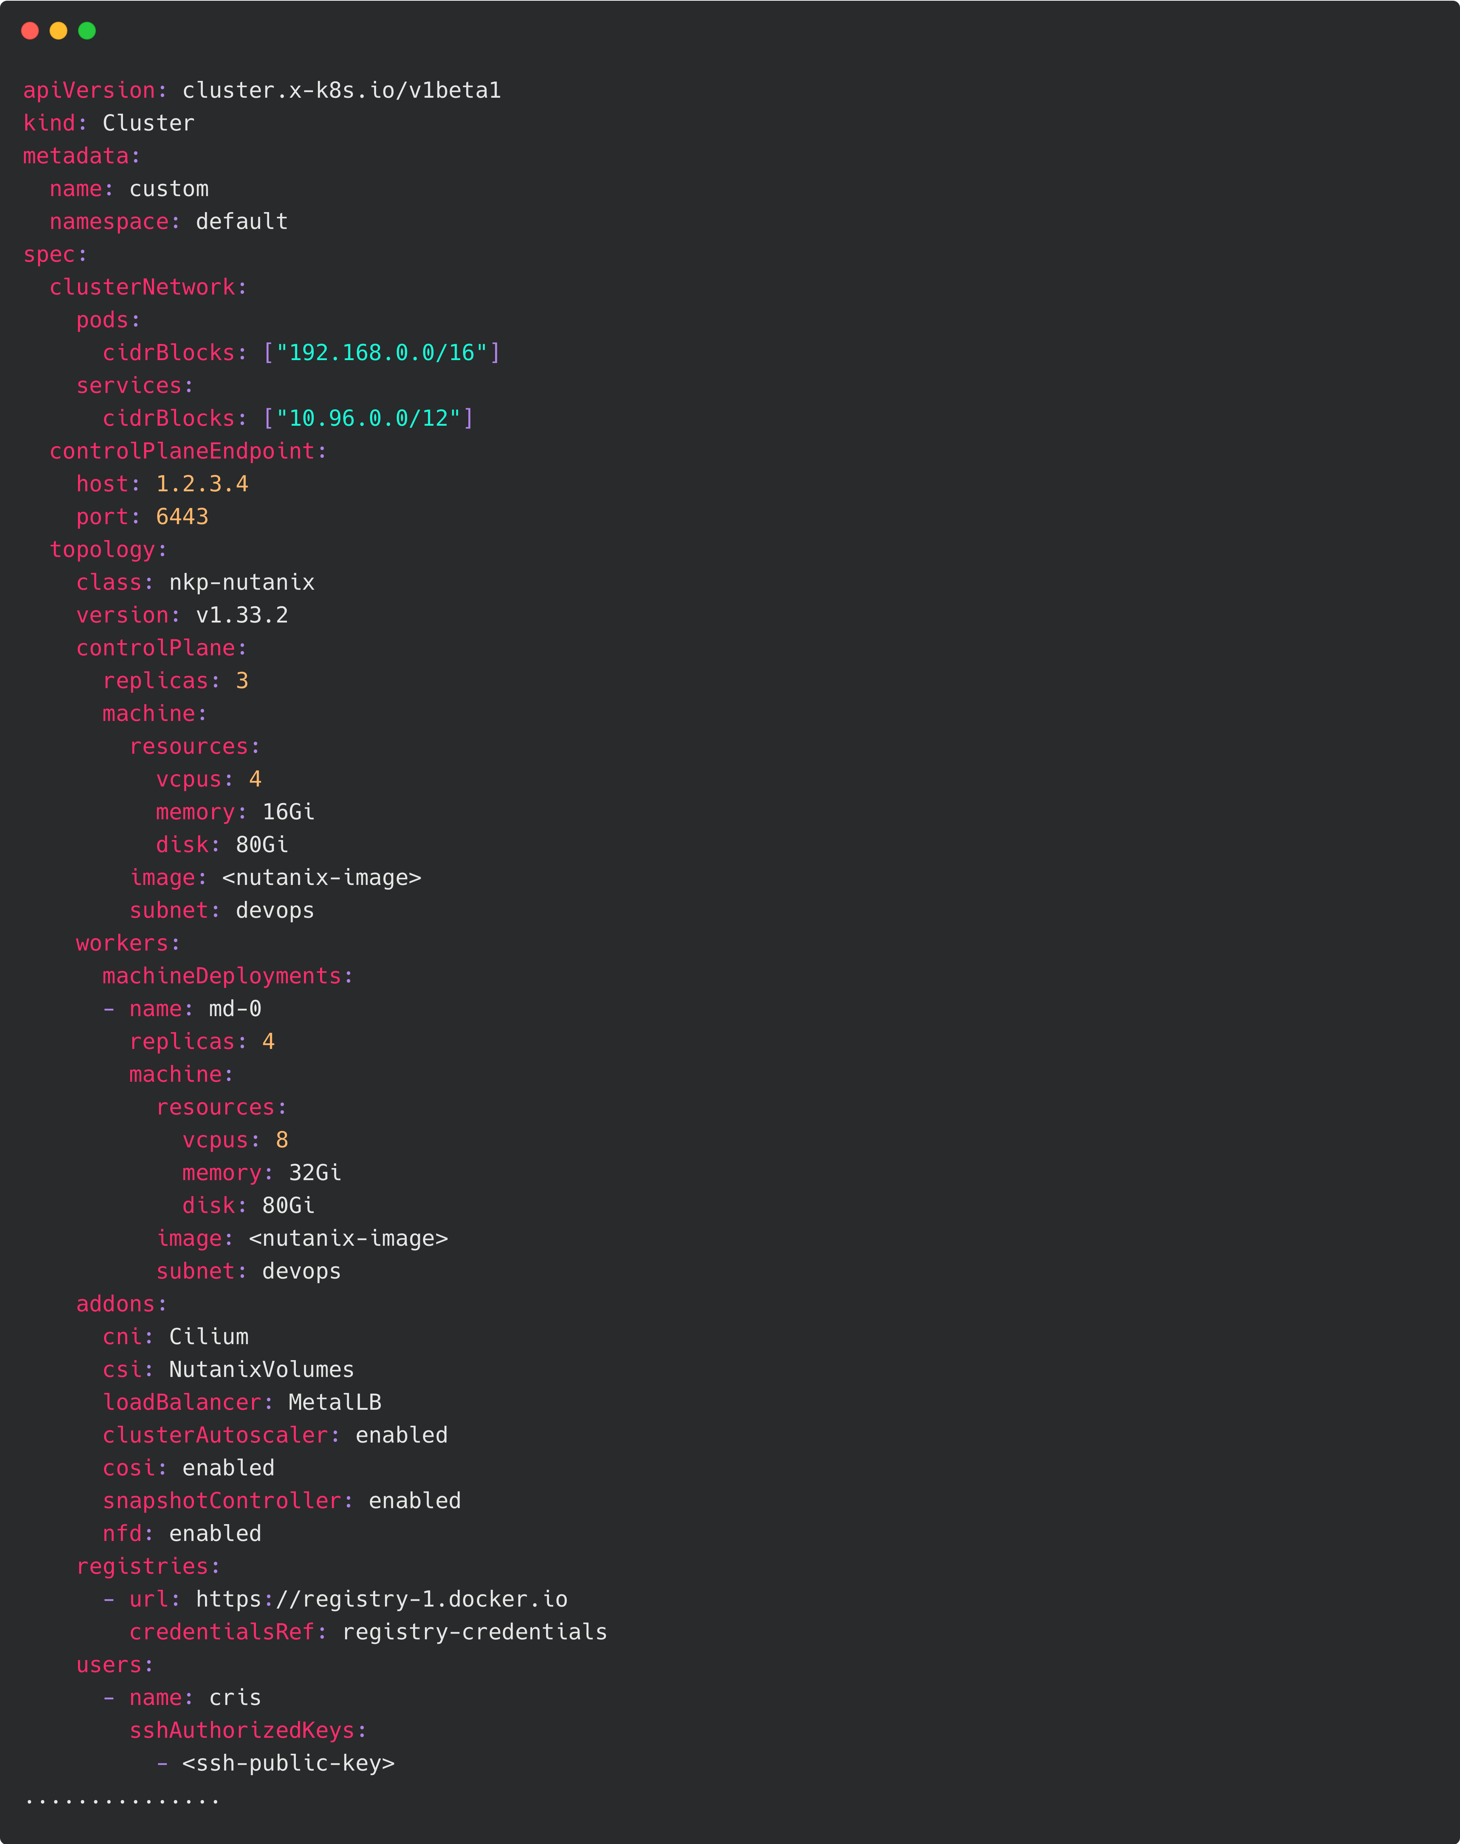
Advanced install steps
Create bootstrap (if no mgmt cluster)
nkp create bootstrap
Create cluster dry-run definition files
nkp create cluster nutanix -o yaml --output-directory <dir> --dry-run ……
Modify cluster-custom.yaml
CAPI
CAPX
CAREN
Apply all resources
kubectl apply -f <dir> --server-side
Finish install
nkp get kubeconfig –c cluster_name > cluster_name.conf nkp create capi-components --kubeconfig cluster_name.conf nkp move capi-resources --to-kubeconfig cluster_name.conf nkp delete bootstrap

Slide 32

Network Advanced Configuration

Slide 33
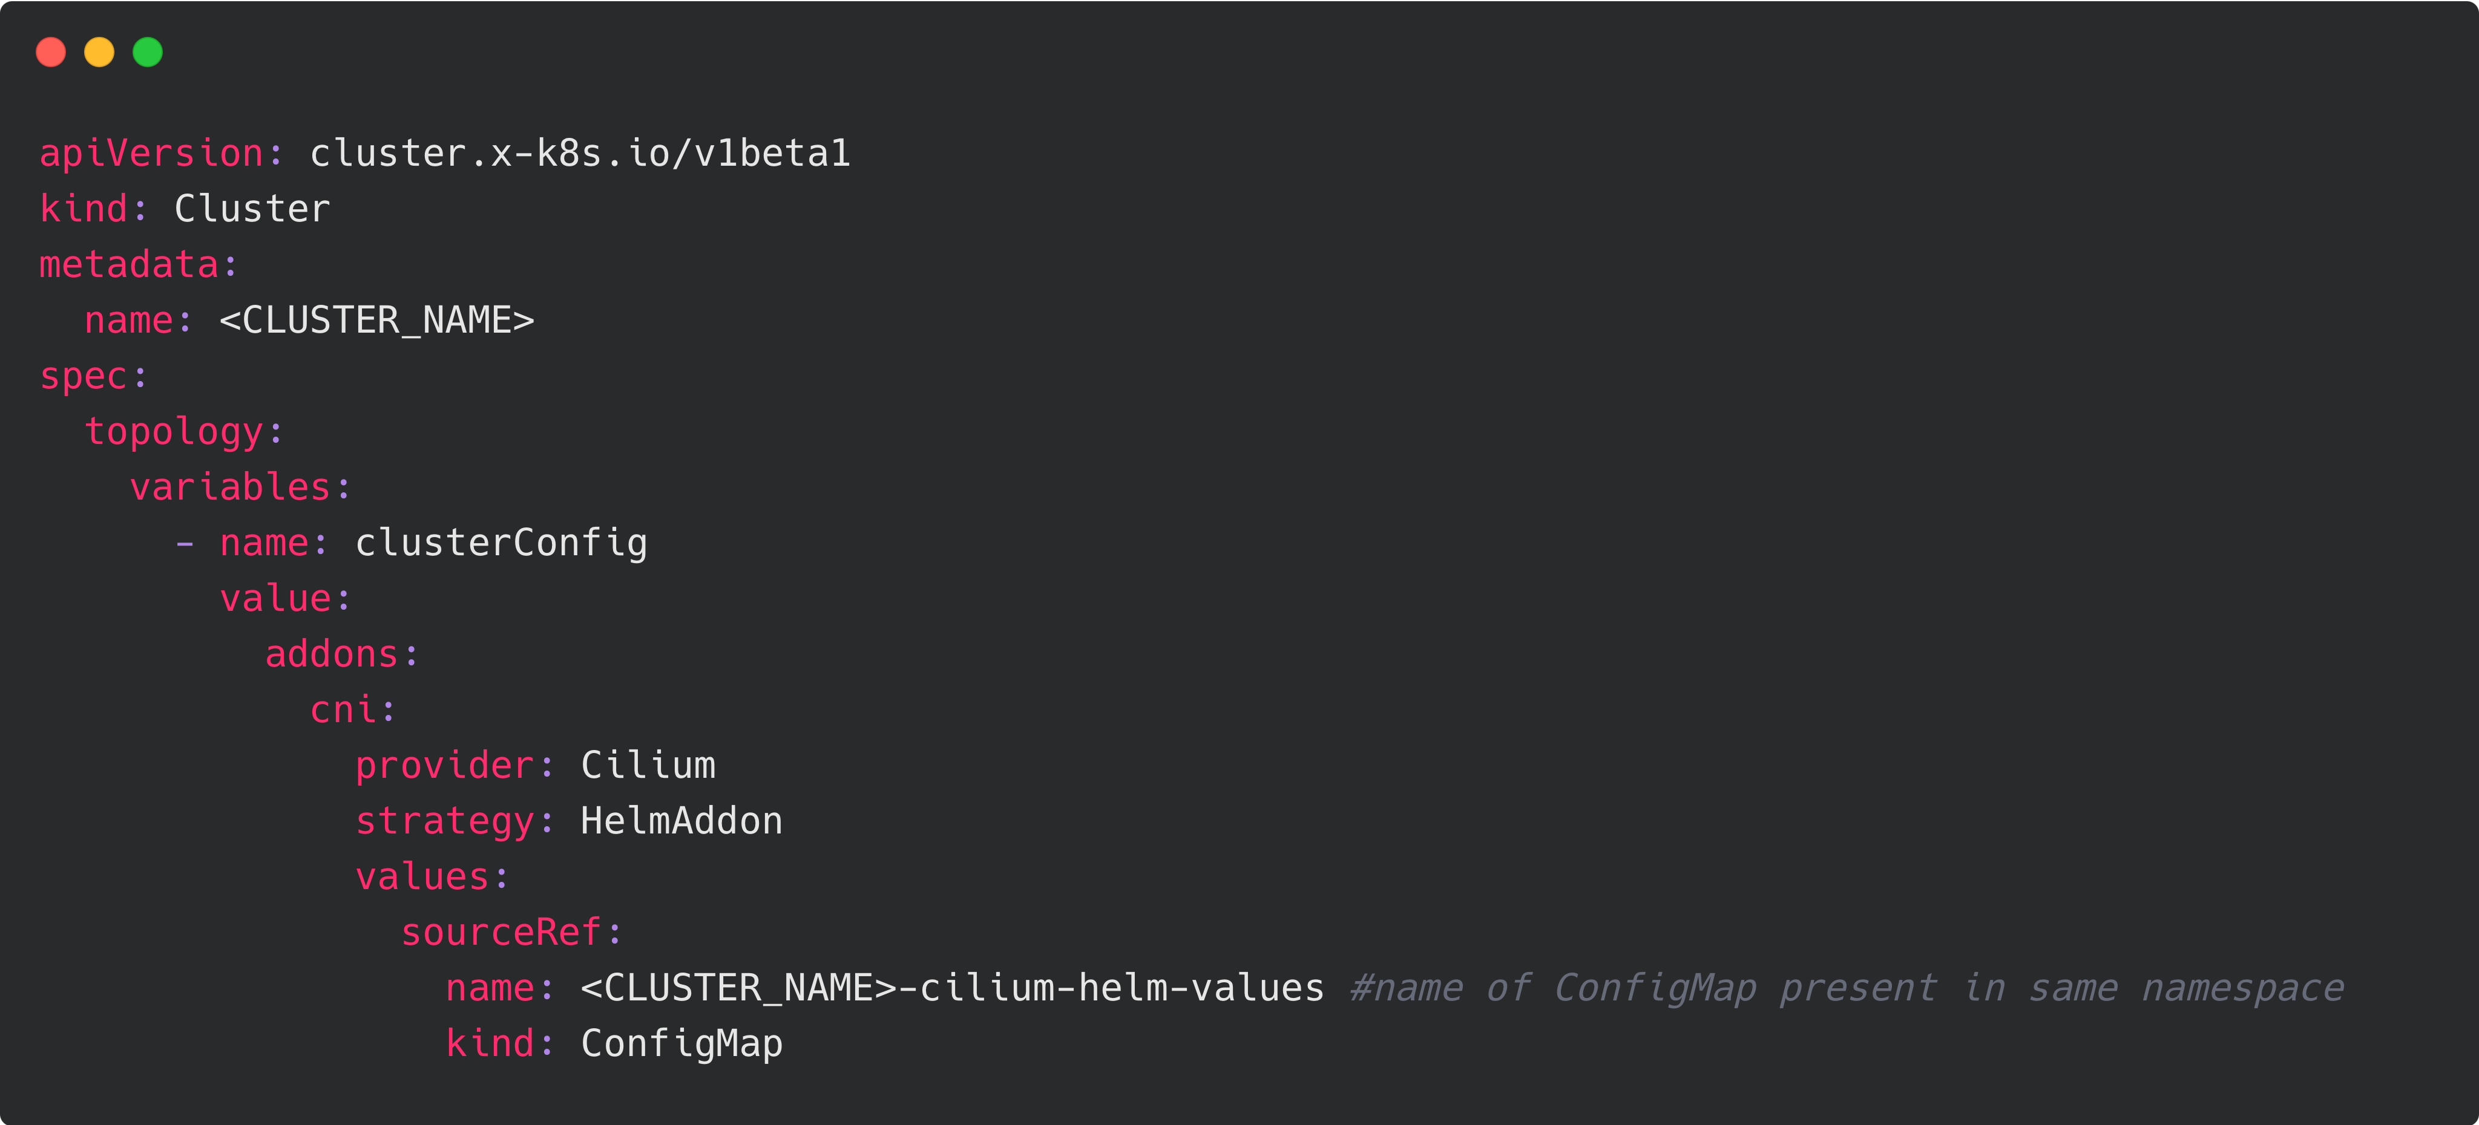
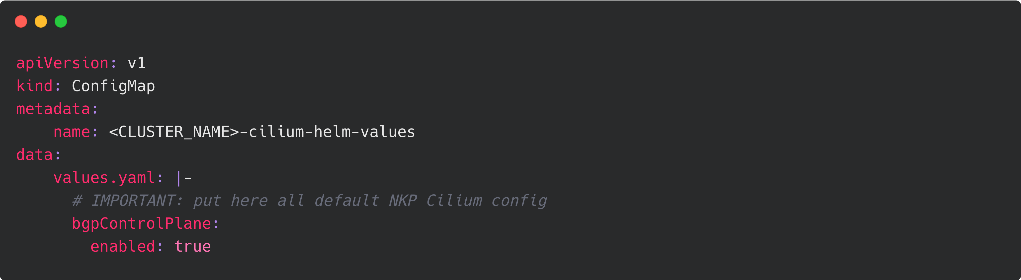
Cilium Advanced Configuration
Only available with NKP advanced install.
Give full access to all Cilium configuration options.
ConfigMap should contain all Helm values for Cilium, it will replace default NKP Cilium configuration
https://www.nutanix.dev/2025/09/17/how-to-enable-cilium-cluster-mesh-in-nutanix-kubernetes-platform/

Slide 34
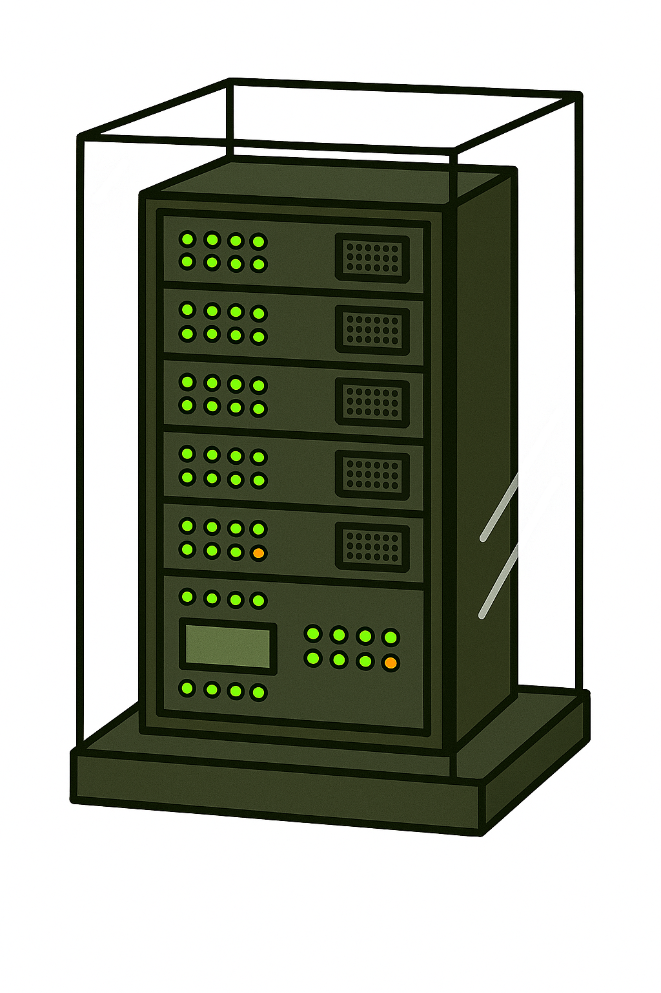
Airgap install
Notes:
Adresser airgap first pour NKP2.16+

Slide 35
Built for Airgap Environments
Air-gapped Deployment
(VM / Bare Metal / “GovCloud”)
Purpose-built automation
Streamlined Kubernetes solutions specifically designed for seamless air-gapped environments, ensuring optimal performance from the ground up.
Secure and consistent
Installation processes meticulously tested and documented for speed, ease, and unwavering reliability in every deployment.
Military grade experience
Leverage extensive experience with air-gapped deployments to simplify and strengthen operations for mission-critical environments.
Internet Connected Network
Internet
Connected
System
Security Scanning Tools
USB
FlashGuard
DVD
Download a Single Air-Gapped Bundle
Air-gapped Network
Air-gapped Image Registry
Security Scanning Tools
USB
FlashGuard
DVD
NKP Cluster
Node Group(s) (Microservices, AI/ML, Data Services)
HA
Control Plane
CPU Group
GPU Group
Notes:
There are a lot of circumstances in which you need to operate in an air-gapped environment . . .
There are times, for reasons of security, regulatory compliance, or necessity, that you must operate in an air-gapped environment. We are experts in helping our customers meet the challenges of that kind of environment; we have listed some here. Which reasons are driving you to consider an air-gapped deployment? [discuss]
Running production Kubernetes in an air-gapped environment requires both the right technology and the expertise to use it. That includes a Kubernetes distribution developed from the ground up with air-gapped installations in mind, the automation necessary to make air-gapped installations simple and repeatable, with the ability to meet complex requirements through configuration, not customization, thoroughly tested and well-documented processes, and an expert partner with a history of success: why waste your time learning through trial, error, and repeated failure the lessons we have already learned and built into our products and procedures? We provide all of these things--which is why we have repeatedly beaten our (much larger) competitors and supplanted failed customer DIY attempts in some of the most challenging environments around.
Some of the complexity may be easier to understand when pictured. You typically think of an air-gapped environment on-premises . . .
Some of the ways we remove risk and accelerate deployment:
We provide tooling that prepares a machine using a local rpm repo and image registry
We also built the tooling to run a pre-flight check to make it fast and easy to validate that the environment is correct for installation
We documented the entire workflow, step-by-step, to make it easy for anyone to provision an air-gapped cluster
But while it seems oxymoronic, you can also create air-gapped environments in the cloud—it’s very much like running on-premises, only the premises belong to Amazon or Microsoft, or Google--with a few extra twists in place of the physical air-gapped network boundary.
---
ONLY IF CUSTOMER ASK
License tier:
NKP: All
---

Slide 36
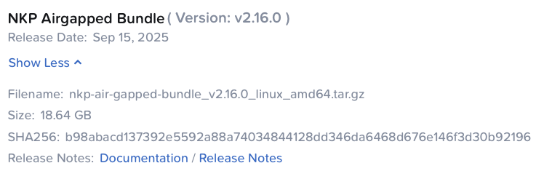
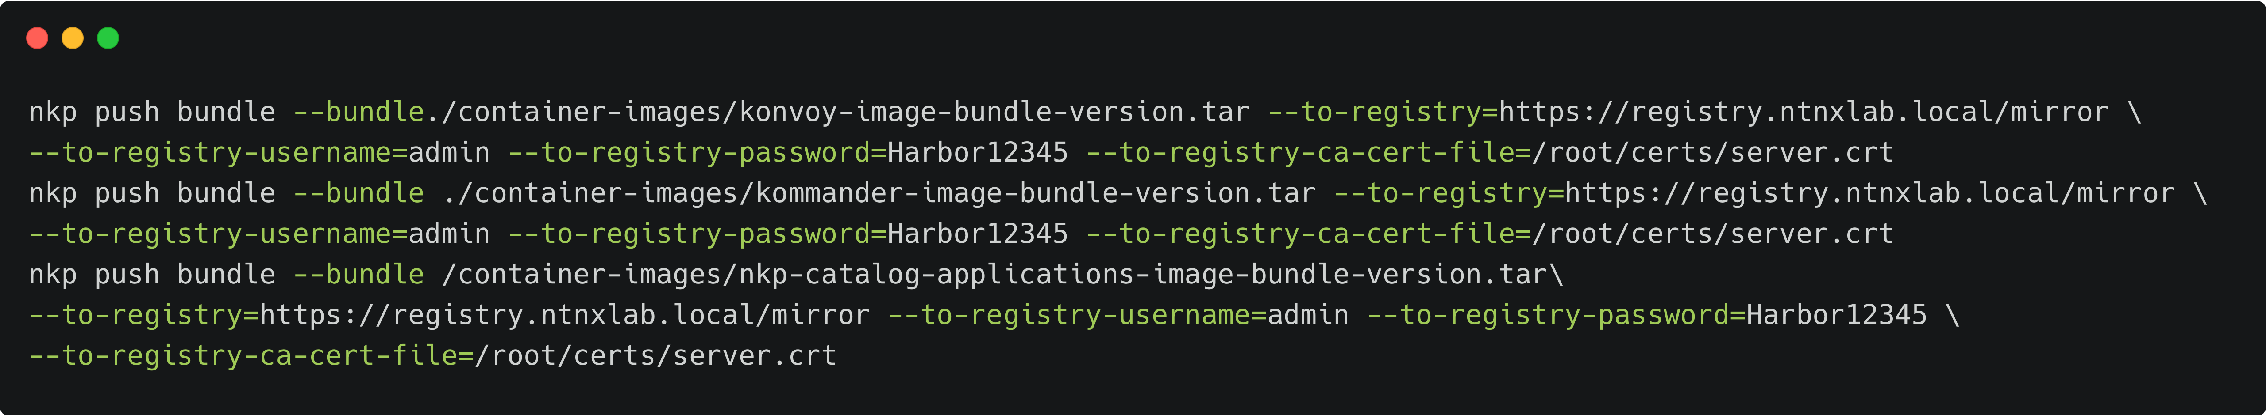
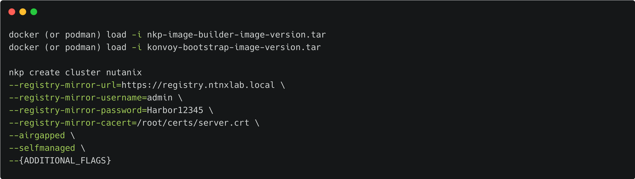
Airgap NKP Deployment
Download NKP Airgapped Bundle
Single Tarball, contains every single Image and CLI or tooling required with NKP
Includes Platform Apps too!
Mirror Images from Airgapped Bundle to Private Image Registry
3 Simple commands!
Deploy NKP
Load the prerequisites
Use the --registry-mirror flags
Use the --airgapped flag
TUI CANNOT BE USED FOR AIRGAPPED
Command on the right is not the full command
Make sure to include additional flags as required

Slide 37
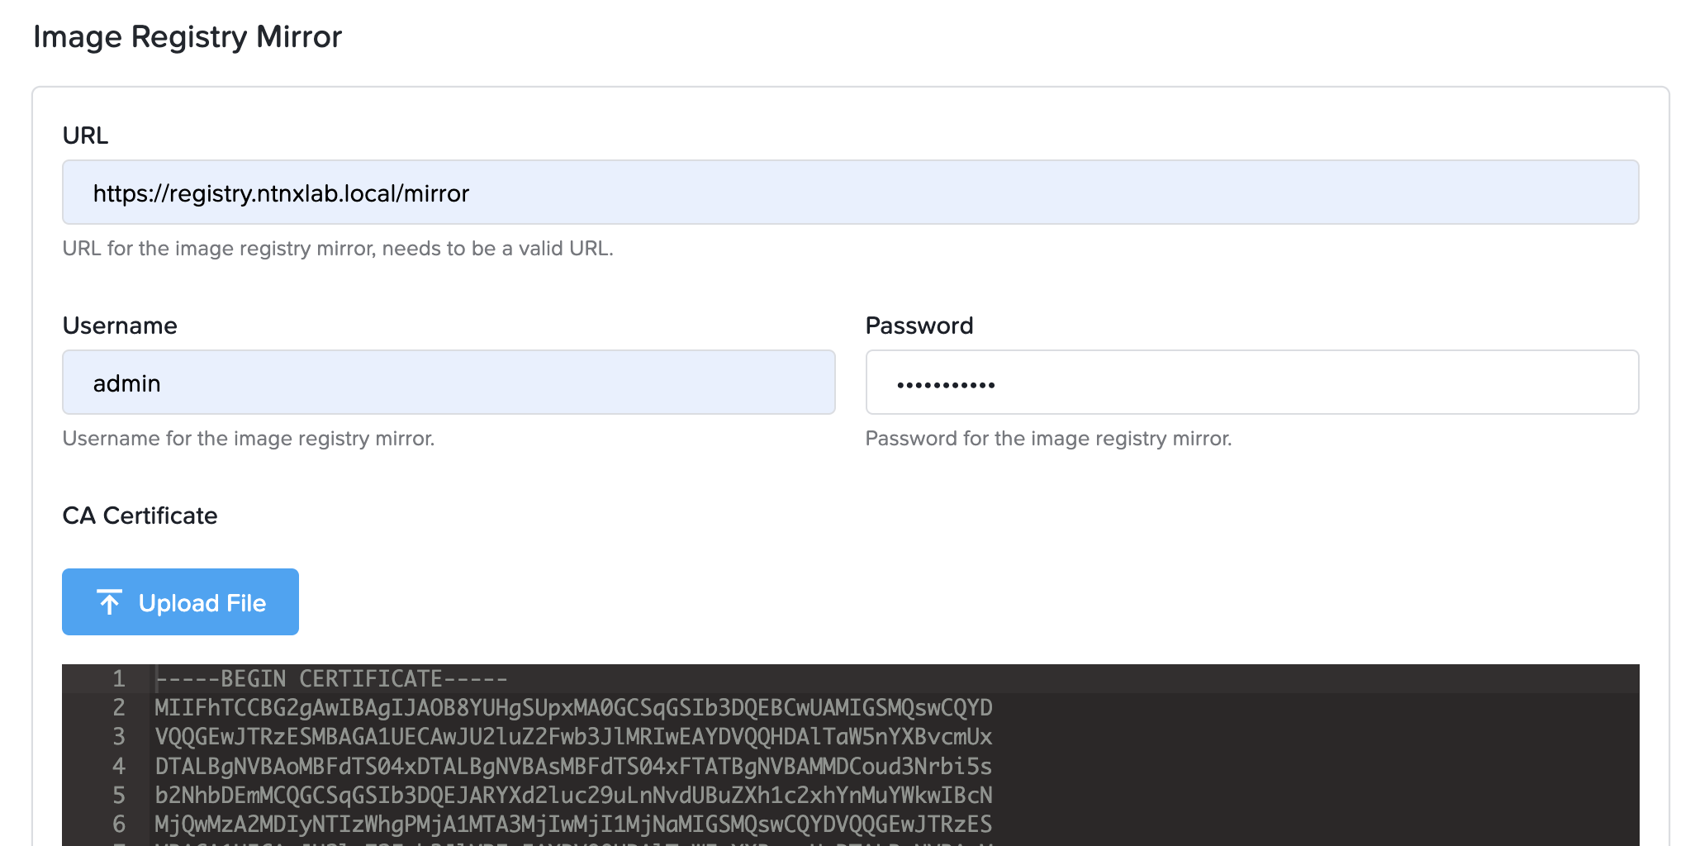
Airgapped NKP Workload Cluster Deployment
Deploy Airgapped NKP Workload Clusters via Kommander GUI
Make sure to specify Image Registry Mirror Definitions

Slide 38
Internal Registry: Simple AirGap Architecture
New 2.16
No External Registry Needed
NKP mgmt
Control Plane
Bootstrap kind cluster
Registry pod
Copies
image bundle
2
Mounts
image bundle
Simplicity
Reduces setup complexity with fewer moving parts to manage
Time
Faster deployment time in greenfield environments
1
Worker
Worker
nkp create cluster nutanix \
--self-managed --bundle …
NKP mgmt
NKP managed
1
Control Plane
nkp create cluster
nutanix
Control Plane
Secure
Avoid exposure to the internet or public registries
Flexible
Works seamlessly whether you are connected or fully isolated
Registry pod
Registry pod
2
Syncs
image bundle
Worker
Worker
Worker
Worker
Notes:
One of the biggest pain points in restricted or greenfield environments is having to stand up a private registry before you can even start deploying Kubernetes. With NKP on AHV, that complexity goes away because the installation bundle includes everything you need, including an internal registry. The registry automatically hosts all the images required to set up the cluster – this means you get faster time to deploy, fewer moving parts to manage, and a system that’s secure by default because you don’t need to expose the cluster to public registries or the internet. And importantly, it works flexibly in any environment, whether you are fully disconnected or connected.
There is no lock-in at all! If you already have a private registry, you can continue using it. If you are comfortable relying on public registries, you can do that too.
This design makes NKP a perfect fit for secure, regulated, or disconnected environments, while still offering the freedom of choice for customers who want to integrate with their existing registries.
How it works
1. Pass the –bundle flag at deployment time pointing to the downloaded NKP installation bundle.
2. The bundle is mounted into the kind bootstrap cluster.
3. The NKP management cluster’s first control plane node boots up, and the registry pod is created.
4. The image bundle is copied from the bootstrap cluster to the registry in the management cluster.
5. All the remaining nodes and platform applications will pull images from the registry and come up.
When creating a managed cluster, the workflow is similar – A registry syncer job is created in the management cluster that copies the images from the management cluster to the registry pod in the workload cluster.
Best practise: Keep the bootstrap cluster (in the jump host or local machine) as close as possible to the AOS cluster hosting the NKP management cluster to minimize the time taken in copying images.
Note: If the NKP management cluster has been created using the airgapped first workflow, then the managed clusters will use it as well by default. However, if you would like to use a private registry, you can override it by passing the mirror registry flag.
Change to OS images
The OOTB OS images available in Nutanix portal will have certain container images baked into it to bootstrap the OS (CNI, CSI etc). Alternatively, when creating custom images, pass in the –bundle flag when running “nkp create image”.
---
ONLY IF CUSTOMER ASK
License tier:
NKP: All
---

Slide 39
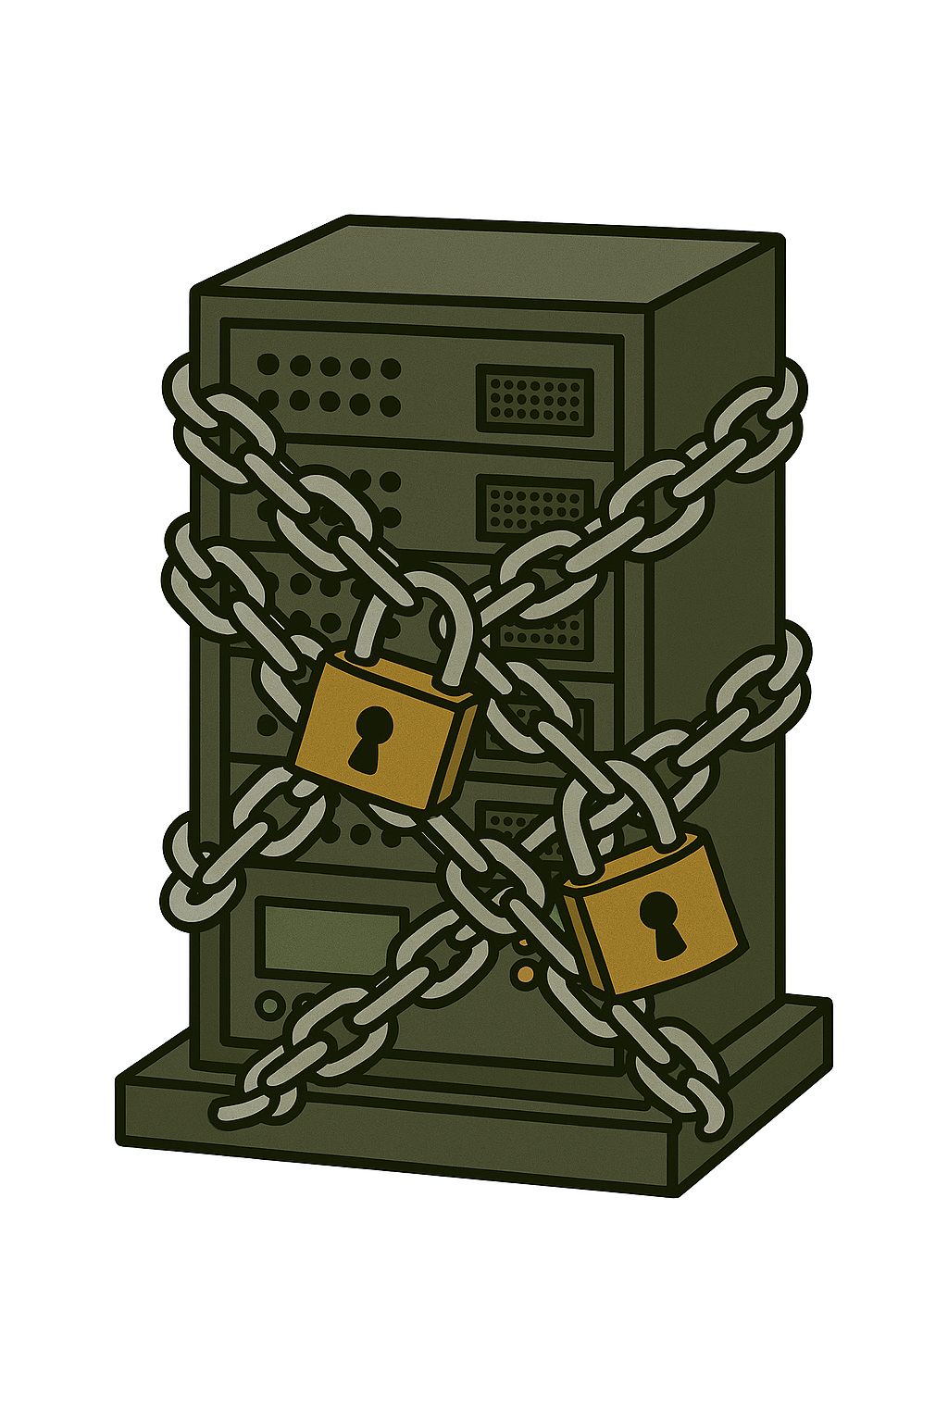
VPC install
Notes:
Adresser airgap first pour NKP2.16+

Slide 40


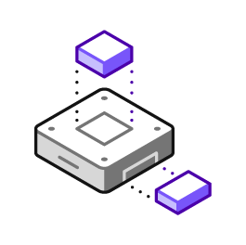
Benefits of deploying NKP in VPCs
Simplified Networking
Seamless pod communication
Reduced management overhead
Enhanced Scalability
Large Cluster sizes
Reduced stress on Infrastructures
IP address management
Flexibility in Deployment
Multi-tenancy
Infrastructure Agnostic
IP space reuse
Notes:
Before we go into multiple scenarios, Lets understand why it matters

Slide 41

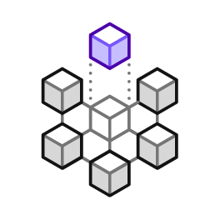
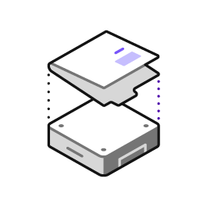

Pre-requisites and Considerations
Connectivity NAT/No-NAT
Files/Objects
Prism Central
Package
Image Repo
Storage, Image registry
external network: 10.10.10.0/24
Prism Central API and image repo access
Ingress exposed / not exposed
VPC
172.16.0.0/16
Overlay net
172.16.1.0/24
NKP cluster
(Self-managed
Control Plane
Ingress exposed/Not exposed
Worker Nodes

Slide 42

Doing a Restrictive deployment in Overlay Networks is easy!!
Bastion host/Admin VM
Hosts all the components needed to create a cluster, images, local repository, etc.
Allows controlled access to the NKP environment for management purposes
MTU
VPC MTU is 1442, While the Docker network is on 1500
docker network create -o "com.docker.network.driver.mtu=1442" kind nkp create bootstrap
Platform Engineer
Remote access to Bastion host 10.10.10.10
(NAT) external network: 10.10.10.0/24
Bastion VM Floating IP
10.10.10.10
NKP cluster not exposed publicly
VPC
(172.16.0.0/24)
NKP cluster
(Self-managed)
Bastion VM
172.16.0.10
kubectl
172.16.0.20
Control Plane
NKP UI 172.16.0.30
Worker Nodes
Developers using overlay IPs to access NKP cluster
NKP cluster ingress and control plane not exposed
Notes:
we're looking at a deployment architecture for NKP clusters in a NAT-restricted VPC environment. The key component here is the Bastion VM, which serves as our secure gateway. When deploying in this configuration, the control plane and multi-tenant service provider are completely isolated from external access, making it highly secure
The Bastion VM provides controlled access to the NKP environment and houses all essential components for cluster installation, including images and local repositories
A critical feature is the floating IP that's assigned to the Bastion VM for administrative access. The diagram shows the NAT network topology with a VPC restriction, where developers can access the NKP cluster through overlay APIs, and the NKP cluster itself is self-managed with its control plane and worker nodes properly segregated
This architecture ensures both security and functionality while maintaining proper access controls.
NKP clusters in NAT (Restricted)
No control plane and UI accessible from outside VPC makes it highly secure
Scalable for multi-tenancy Service Provider use case
Bastion VM
Allows controlled access to the NKP environment for management purposes
This model requires a floating IP to expose the bastion VM
Hosts all the components needed to create a cluster, images, local repository, etc.

Slide 43
But What About When you want to Expose!!
Additional flags during deployment
--extra-sans <Floating IP Tied to the Control Plane VIP provided to the --control-plane-endpoint-ip flag>
--cluster-hostname < Floating IP linked to the first MetalLB IP in the --Kubernetes-service-load-balancer-ip-range or its associated DNS record >
Floating Ips
Expose additional services of type LoadBalancer requires more floating IPs
Platform Engineer
Remote access:
Bastion VM 10.10.10.10
kubectl 10.10.10.20
UI 10.10.10.30
Developers outside VPC using external IPs to access NKP cluster
(NAT) external network: 10.10.10.0/24
Bastion VM Floating IP
10.10.10.10
kubectl 10.10.10.20
UI 10.10.10.30
VPC
(172.16.0.0/24)
172.16.0.20
172.16.0.30
NKP cluster
(Self-managed)
Bastion VM
172.16.0.10
kubectl
172.16.0.20
Control Plane
NKP UI 172.16.0.30
Worker Nodes
Developers within VPC using overlay IPs to access NKP cluster
NKP cluster ingress and control plane exposed
Notes:
The key here is we are exposing NKP UI and control plane through floating IP that are accessible from outside the VPC, with flow-through security policies implemented at the VPC edge for secured cluster access. For management purposes, we utilize a Bastion VM same as earlier example, which serves as a controlled access point to the NKP infrastructure. A crucial aspect is the implementation of floating IPs to ensure consistent external network accessibility. The diagram illustrates a self-managed NKP cluster setup with distinct components including the control plane and worker nodes, all contained within a VPC with the CIDR block 172.16.0.0/24. The architecture is specifically designed to support multi-tenancy Service Provider use cases, making it highly scalable and secure. Developers can access the NKP cluster using overlay Ips or floating IPs, while platform engineers maintain control through the designated management interfaces.
NKP clusters in NAT (Un-restricted)
The control plane and UI are accessible from outside VPC
Flow Network security policies can be implemented at the edge of VPC for secured access to Cluster
Scalable for multi-tenancy Service Provider use case
Bastion VM
Bastion VM (Admin VM) still recommended for deployment and controlled access to the NKP for management purposes
Floating IPs
Ensure enough floating IPs are available in the external network

Slide 44
Multi-tenancy Scenario
Tenant 1 Access
Tenant 2 Access
Tenant 3 Access
Remote access to Bastion host 10.10.10.10
Remote access to Bastion host 10.10.10.110
Remote access to Bastion host 10.10.10.210
(NAT) Service Provider external network: 10.10.10.0/24
Bastion VM Floating IP
10.10.10.10
NKP cluster not exposed publicly
Bastion VM Floating IP
10.10.10.110
NKP cluster not exposed publicly
Bastion VM Floating IP
10.10.10.210
NKP cluster not exposed publicly
VPC A
(172.16.0.0/24)
VPC B
(172.16.0.0/24)
VPC C
(172.16.0.0/24)
NKP cluster
(Self-managed)
NKP cluster
(Self-managed)
NKP cluster
(Self-managed)
Bastion VM
172.16.0.10
kubectl
172.16.0.20
Control Plane
Bastion VM
172.16.0.10
kubectl
172.16.0.20
Control Plane
Bastion VM
172.16.0.10
kubectl
172.16.0.20
Control Plane
NKP UI 172.16.0.30
Worker Nodes
NKP UI 172.16.0.30
Worker Nodes
NKP UI 172.16.0.30
Worker Nodes
Notes:
SP shared component as external network

Slide 45
Best practices

Slide 46

Certificates management

Slide 47
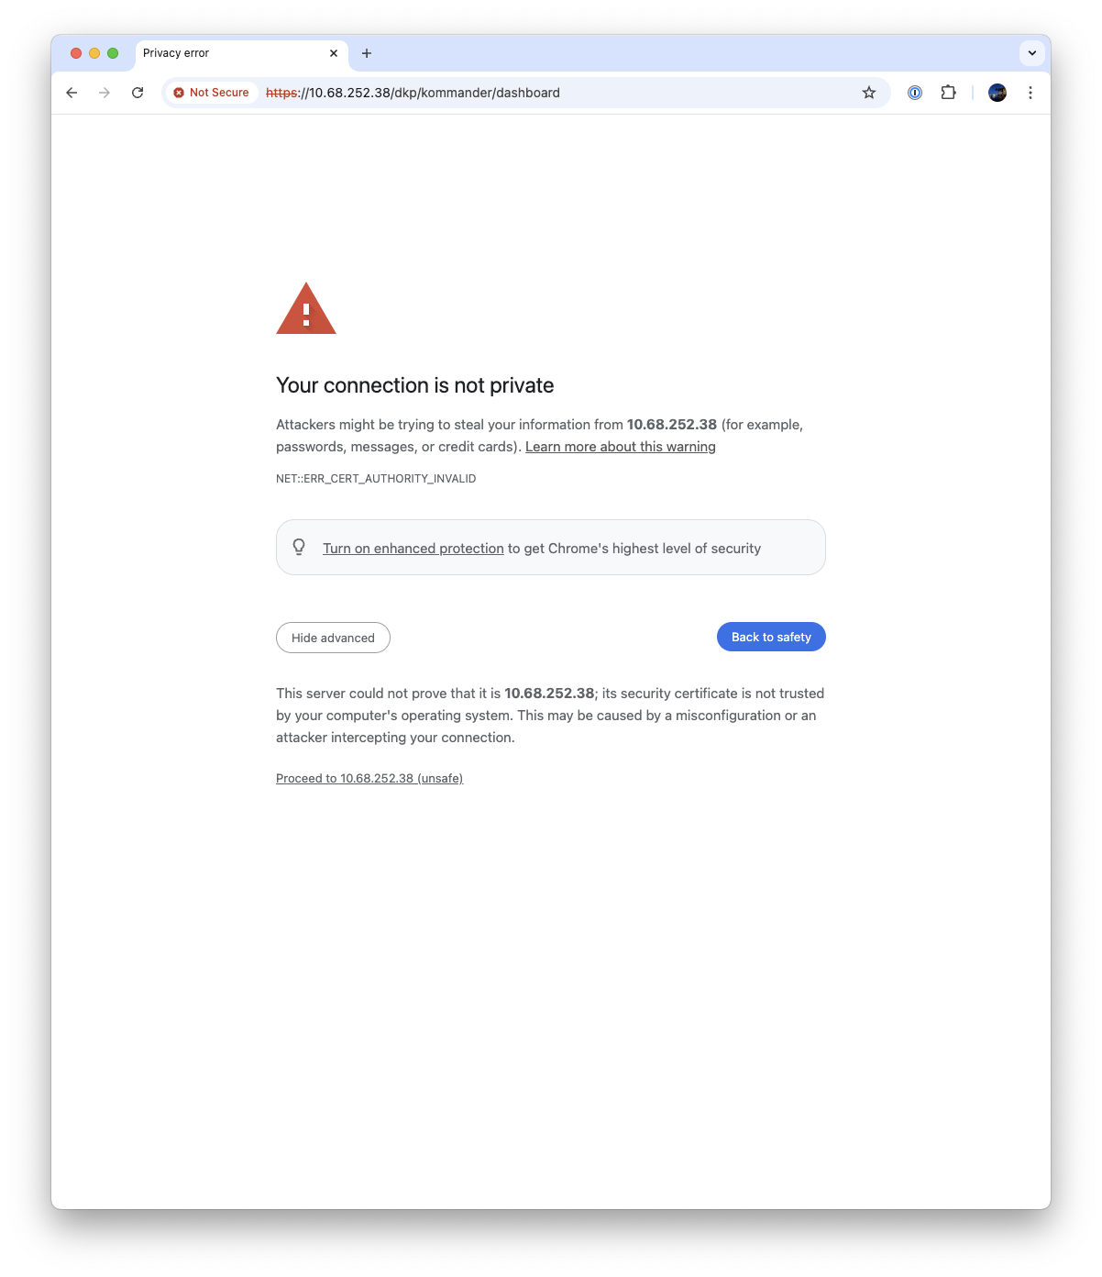
NKP default certificate behavior
NKP provides 2 secure entry points:
Kubernetes API Endpoint (--control-plane-endpoint-ip) by default on port 6443
NKP UI (--kubernetes-service-load-balancer-ip-range) on port 443 through the ingress controller
Kubernetes API Endpoint is using self-signed certificate
Not an issue because included inside kubeconfig
This is how Kubernetes works
NKP UI is also using by default self-signed certificate
This is where problems start ➔ ➔ ➔
Notes:
Wolfgang:
In terms of K8s in general and NKP specific, we will find certificates in these two configs:
First is API endpoint:
Thats easy because the selfsigned certificate needed for communication with the K8s API is part of kubeconfig. If you have your kubeconfig, you can securely interact with your k8s
Second is NKP UI which is exposed via HTTPS on first available IP from our MetalLB range, also here there is a self-signed certificate by default, and – booom – welcome to team „thisisunsafe“

Slide 48
Create your own Certificate/ Private PKI
CLI tools to manipulate certificates and create your own PKI easily
➔ https://smallstep.com/docs/step-cli/installation/
➔ https://github.com/FiloSottile/mkcert
Create your own root CA (root certificate)
step certificate create mylab-ca mylab-ca.crt mylab-ca.key --profile root-ca
Create your own intermediate CA
step certificate create mylab-intermediate mylab-intermediate.crt mylab-intermediate.key --ca ./mylab-ca.crt --ca-key ./mylab-ca.key --profile intermediate-ca
Create your NKP certificate (and other certificates you need for your infrastructure)
step certificate create next.nxlab.fr next.nxlab.fr.crt next.nxlab.fr.key --ca ./mylab-intermediate.crt --ca-key ./mylab-intermediate.key --bundle --no-password –insecure --not-after=8640h
can configure additional SAN with --san=XXX option, be careful to mention the CN also as an additional SAN
If no DNS you can use wildcard DNS services => ex: my-cluster.192.168.1.2.sslip.io
You can also specify key type (RSA, EC,…) with --kty option depending on the product you want to generate a certificate for
Install the root CA in your computer trust store for proper testing
step certificate install mylab-ca.crt
Notes:
Lets do a step back and talk about how to make it better, not only for NKP, think also about certificates in PrismCentral or Nutanix Objects.
If you ever tried to use Openshift IPI installation you will know that they expect a valid and trusted PC certificate for successful install.
Step-cli is a toolset which makes it very easy to create certificates for every need.
You will start to create a CA-Cert, that’s something you should maybe only doing once for your labs and then try to use it always – why I will tell you later
After creating the CA you can create intermediate or sub-ca, which might be helpful if you want to delegate future cert creation into k8s with cert-manager.
Or you just create the certs itself, as example for PC or NKP UI.
One of the most often asked questions is how to deal with fqdn and dns-records… in HPOC you have ntnxlab.local dns but its also not always easy to configure.
Just build on top of a service called sslip.io, which can be used for almost every use-case and does not require specific dns-configuration in your IPAM
If you want your Cert to cover multiple DNS addresses, you can use –san option, just be ware to mention EVERY dns into the option
To finally leave team “thisisunsafe” you can run the last command to install the CA-cert in your local truststore… now every service using your certs is trusted on your workstation. That’s the reason why to create CA once and then build all your demo/lab-certificates signed by it.

Slide 49
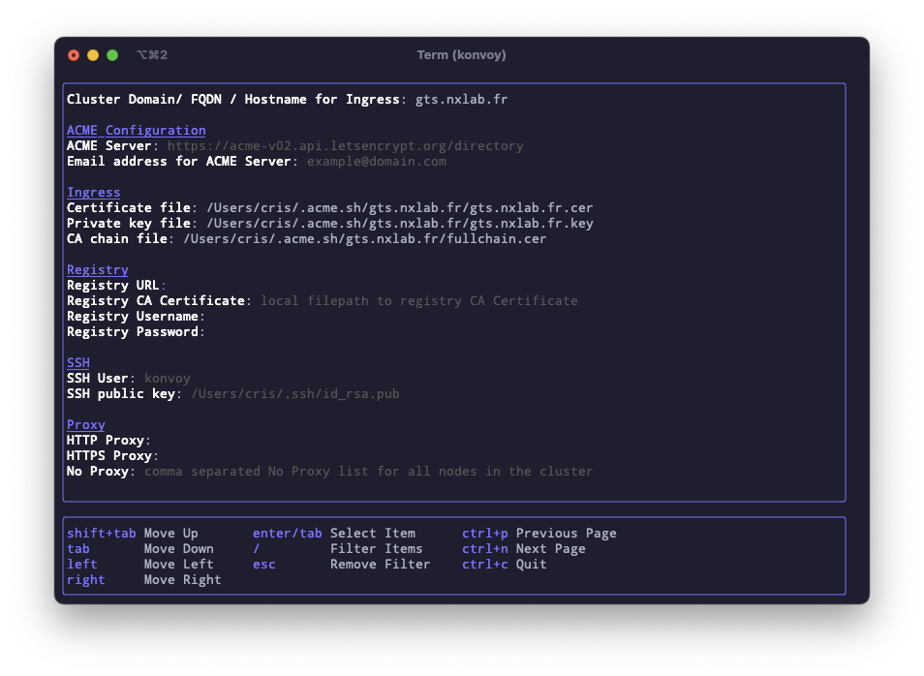
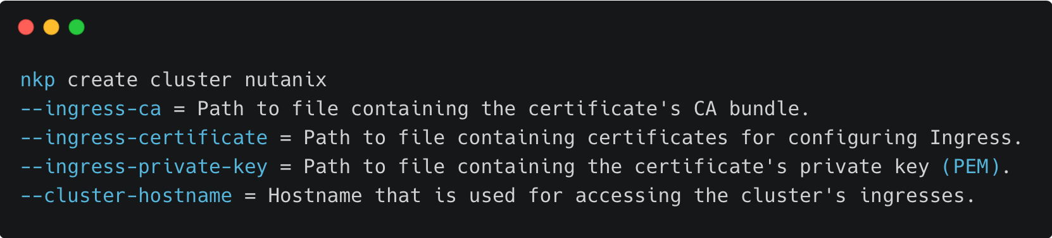
Customize certificate with NKP
Certificate origin:
External self-signed certificate (Step CLI example)
Private PKI (provided by the customers)
Public PKI ( Static, Automated via ACME , …)
TUI option ➔ ➔ ➔
CLI parameters:
DNS config :
Cluster-hostname DNS entry pointing to first address of kubernetes-service-load-balancer-ip-range
Notes:
Now as we have a valid and trusted cert for NKP, how to use it ?
You can inject it into initial deployment during TUI interactive workflow or just passing into as cli-flags (that’s my preferred way)
And again, remember that your DNS/FQDN should point to first available IP from MetalLB range

Slide 50
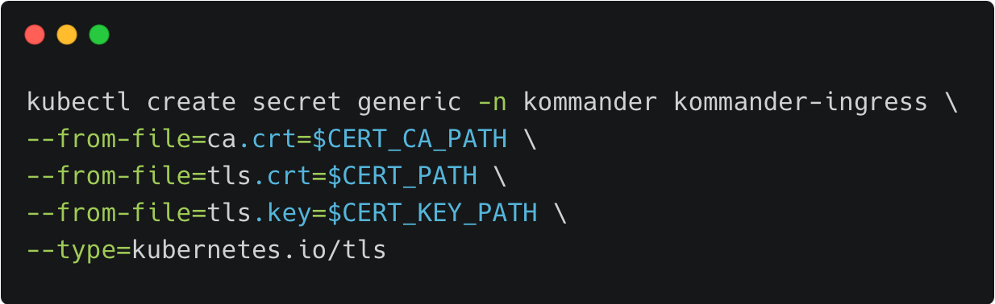
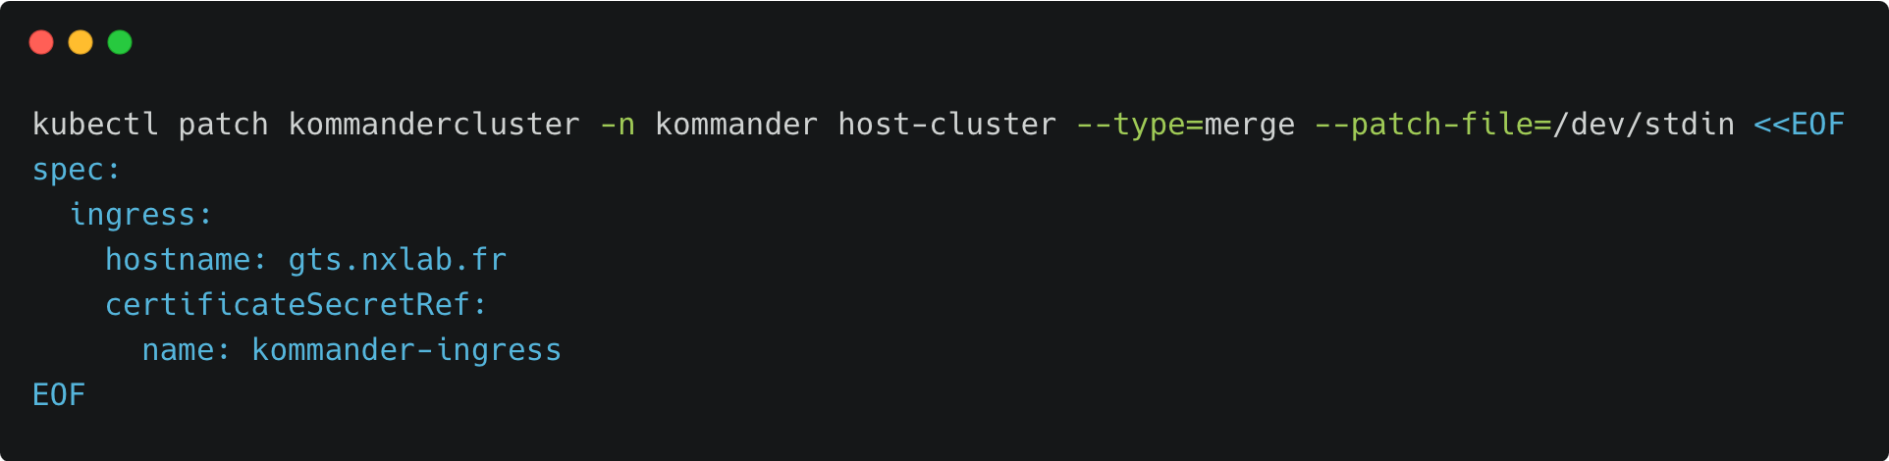
Add certificate to existing NKP cluster
Create certificate
Update kommandercluster in kommander namespace
Notes:
In a different scenario you might already have a cluster and after seeing this session you want to make it more secure, so you need to add certificates to an existing cluster
Shown above you see the command to create a Kubernetes secret which contains your certificate.
Next step is to tell commander which fqdn to use and provide the reference to the secret we have created before

Slide 51
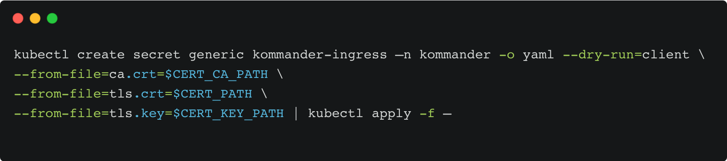
Update existing certificate in NKP
Before certificate expiration update secret kommander-ingress in kommander namespace and modify the values ca.crt, tls.crt and tls.key
Notes:
In case you need to replace existing certificates you can use this command which creates the new secret from cli and then applies it to your cluster

Slide 52
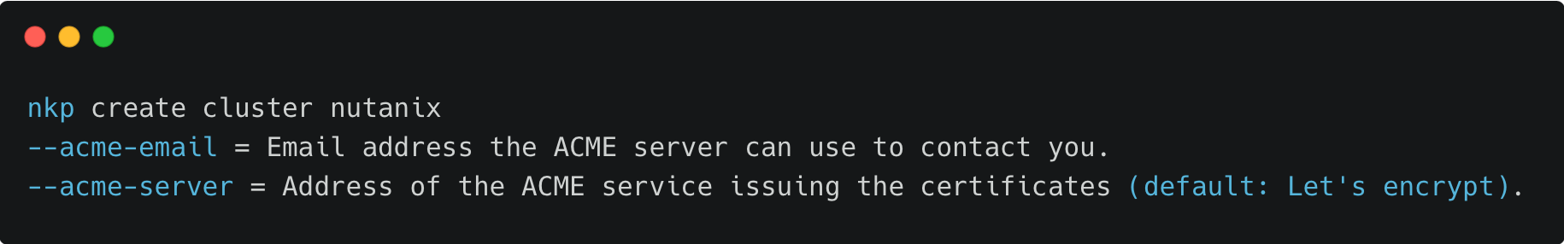
Dynamic certificate management in NKP
ACME option with Challenge HTTP-01
CLI parameters:
Difficult to use because NKP UI need to be publicly exposed
ACME option with Challenge DNS-01
Dynamic link with external DNS providers ( Cloudflare, Route53, Akamai, RFC-2136, …)
No need to expose your cluster publicly
Notes:
NKP uses cert-manager project internally so it is even possible to have NKP manage the certificates by itself.. As example by using LetsEncrypt, this might be helpful to highlight in customer conversations but for demo/lab setup it might be too complex.
Reason is that LetsEncrypt need to verify the FQDN, resulting in:
Exposing your NKP to public internet and use HTTP-01 challenge
Or use DNS-01 challenge which requires that you use an external DNS provider like Route53. My team is using this regulary because it’s the easiest way to get valid public certs.
If you don´t have access to Route53 or Cloudflare, going with sslip.io might be the best way.

Slide 53
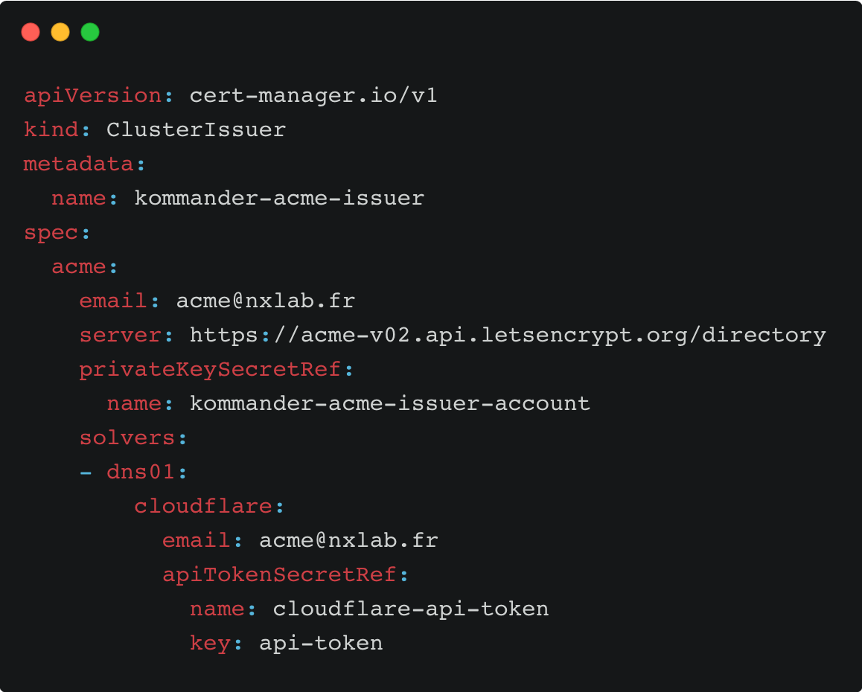
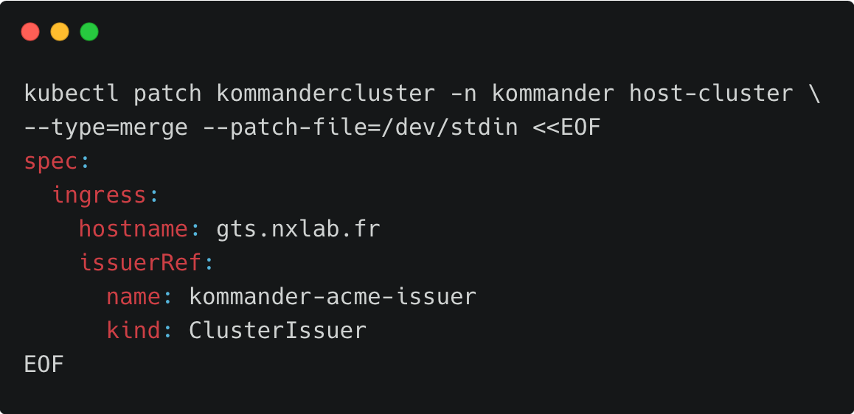
Dynamic certificate management in NKP
Details on how configure ACME option with Cert-manager, Challenge DNS-01 & Cloudflare
Notes:
However, find here how dynamic cert management can be used.
You create a secret containing informations how to access your DNS service,
Then you configure a clusterissuer, which tells cert-manager how to create new certificates, in this case by using ACME/LetsEncrypt
The last step is similar to what we have seen on day2 actions… but this time we do not inject the cert directly but tell commander to use the configured issuer to create the right cert.
Remember we talked about creating intermediate certificates with step ? As a homework you can try to use this intermediate cert with a cluster issuer to get certs, trusted by your local CA.

Slide 54
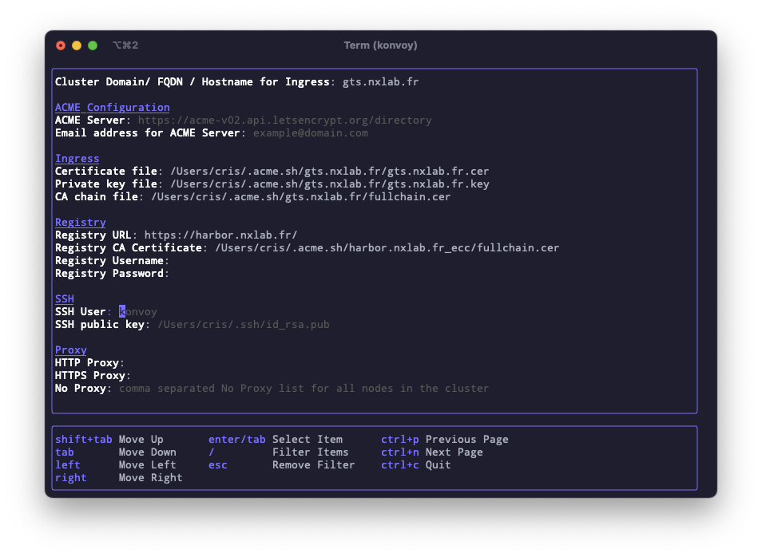
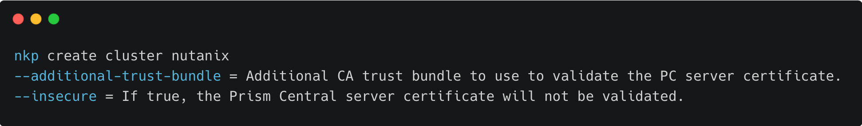
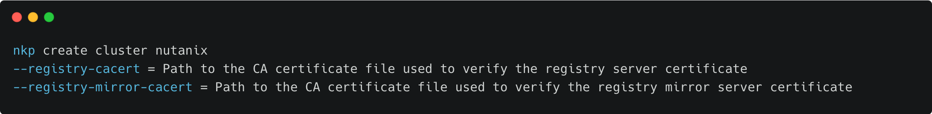
Other certificates involved in NKP lifecycle
Prism Central certificate
Container Registry certificate
Fd
Additional Apps certificate
Static certificate or cert-manager based can be used for your additional applications
Notes:
There are some more places where secured connections are used in NKP. As example for talking to PC… most likely you will have used the insecure flag but if you have custom certs on your PC, you can add the CA here and use an encrypted connection. Remember, if you build your own CA and signed a cert for PC, it might be trusted on your workstation but not within the cluster you are about to deploy.
Same for a certificate you want to use as part of your local image registry, for which I now want to handover to Winson.

Slide 55

Private Registry

Slide 56
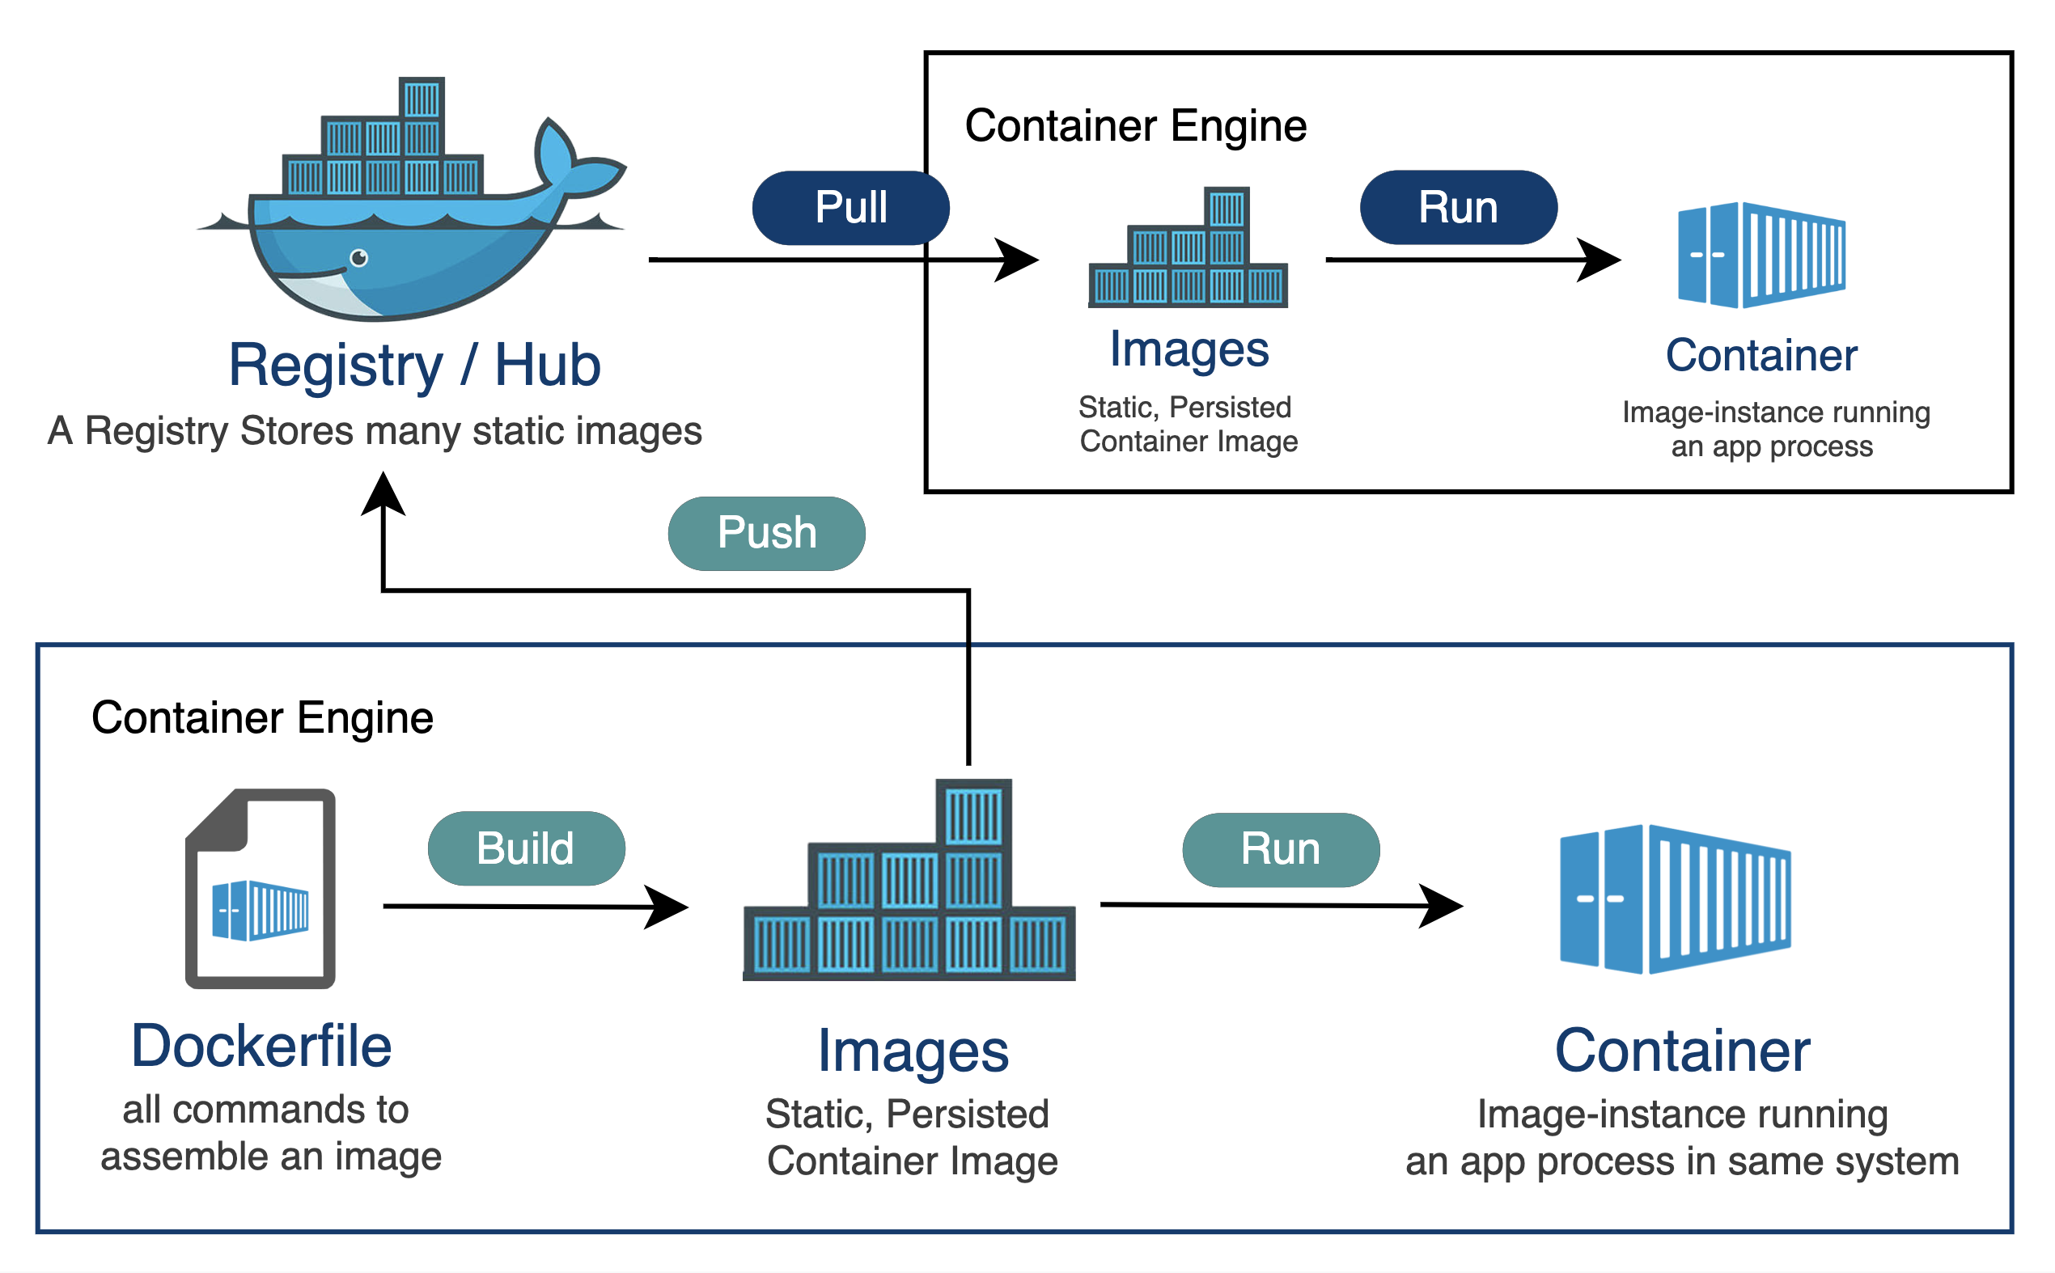
What is a Private Image Registry
Storage Space for Container Images 💿
Searchable catalog of stored Container Images 🔎
Hosted within a customer’s environment 🔒
Could be within On-Premises or CSPs

Slide 57


Why use a Private Image Registry ?
Reduced Network Bandwidth and App Build Times ⏰
Controlled Access 🎮
Security Scanning for Application Components 🔓
Dockerhub (and other registry) Rate Limits 🥺
Air-Gapped Customers
Notes:
We change point 3 from Secure storage by security scanning to introduce scan at the registry level avoid CVE spwan into infra

Slide 58
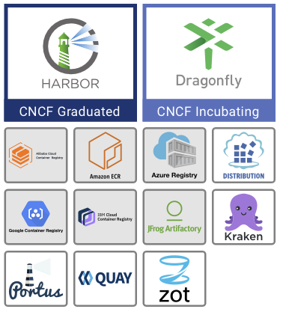


Deploying an Image Registry
Pick an Image Registry of Choice
Harbor
Quay.io
Docker Registry
jFrog Artifactory
Sonatype Nexus
Etc..
First initial deployment as a VM or Bare-Metal (Chicken/Egg)
Deploy with certificates (IMPORTANT!)
Harbor built-in in NKP 2.14+
Notes:
Replace logo by CNCF container registry landscape picture

Slide 59
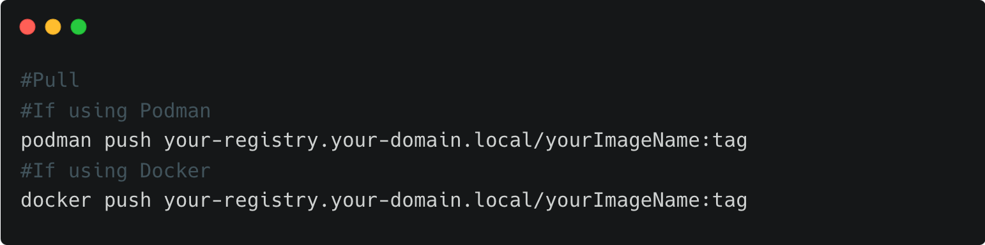
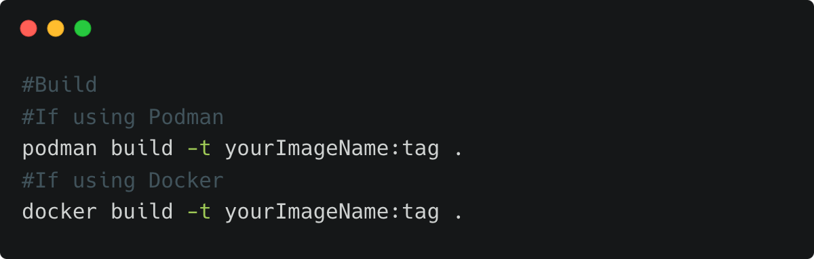
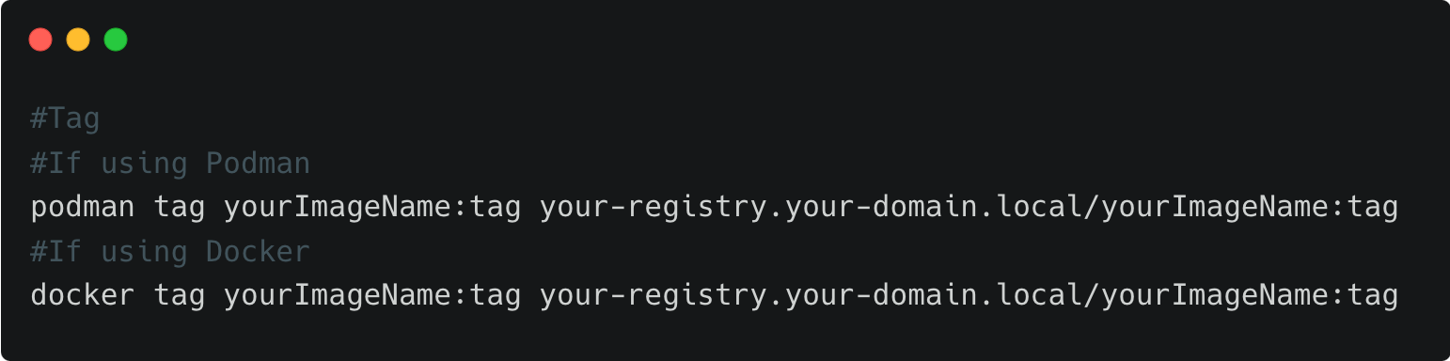
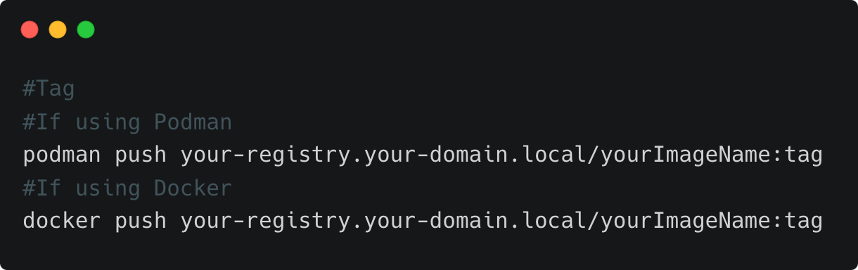
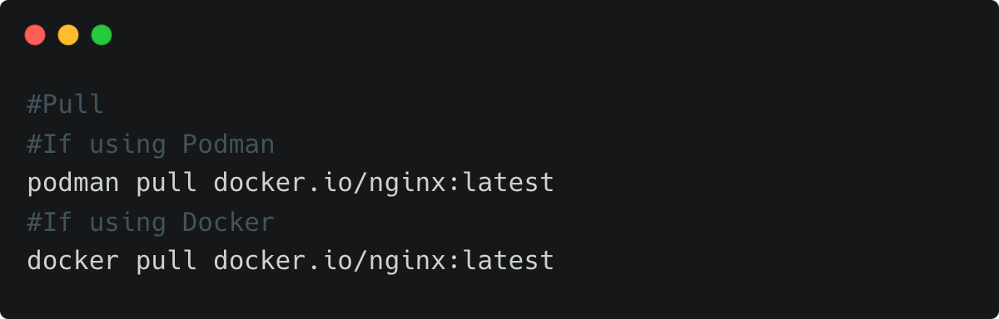
Pushing/Mirroring to an Image Registry
Push Container Images to Private Image Registry
This flowchart is essentially the way to mirror images

Slide 60
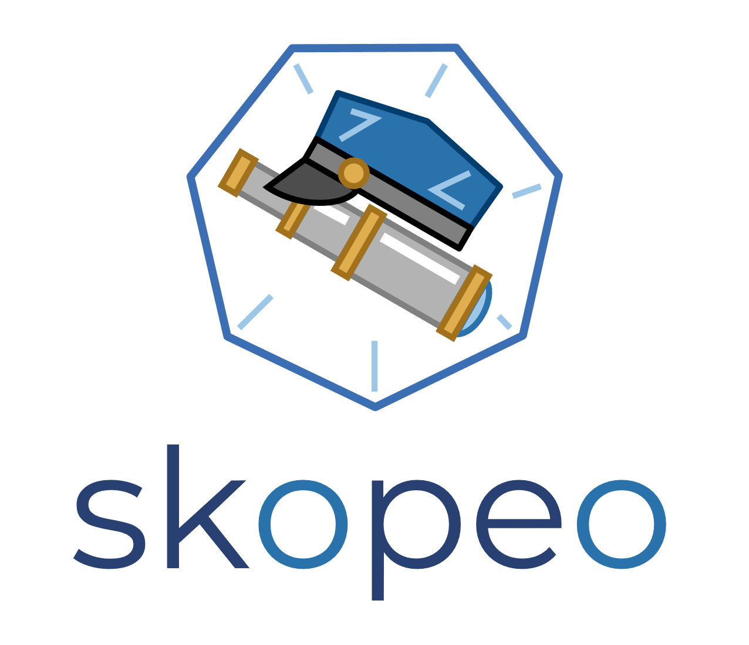
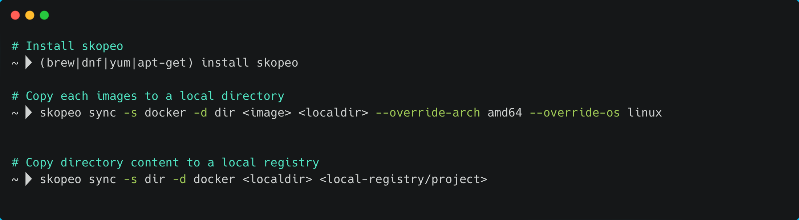
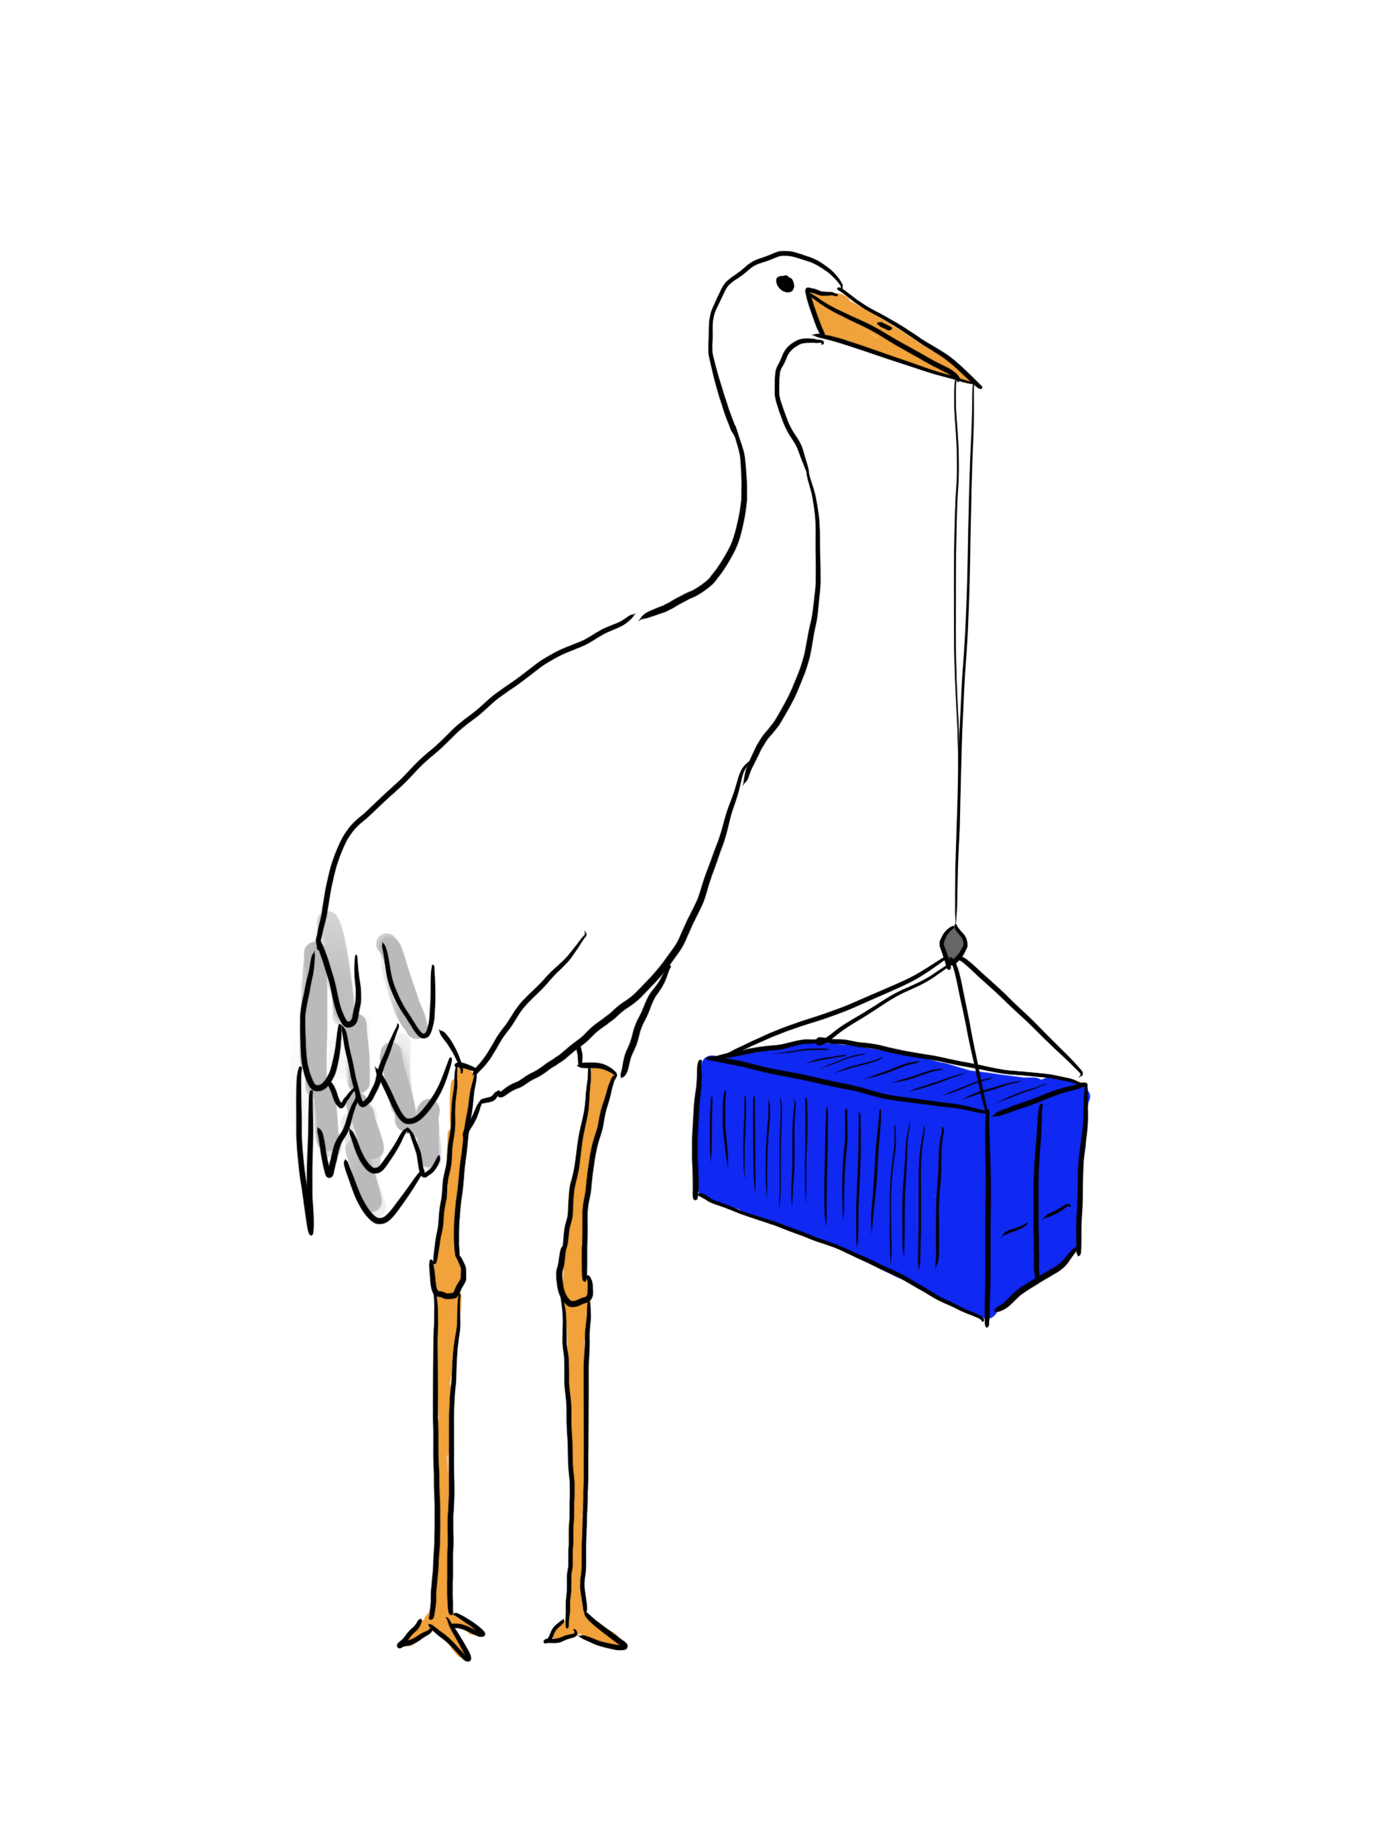
Other tools to mirror images
Skopeo : swiss army knife to migrate container images and image repositories
You can also give a try to crane
Notes:
Crane or not

Slide 61
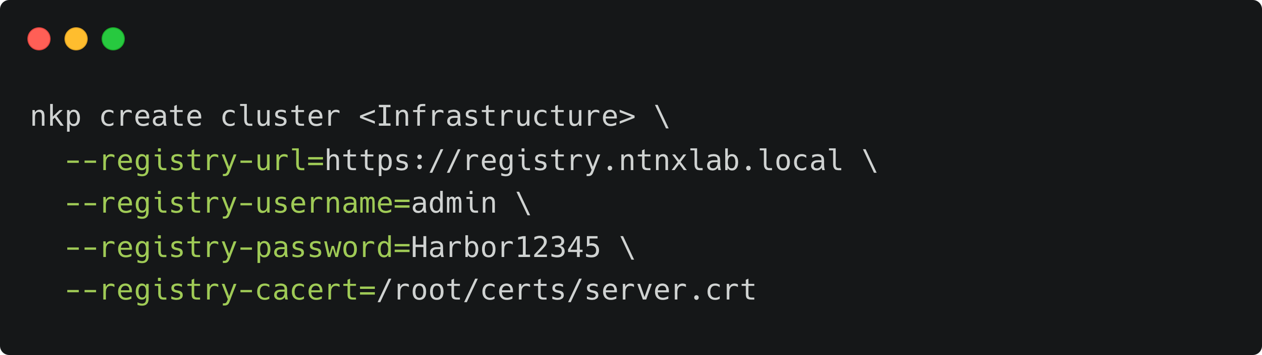
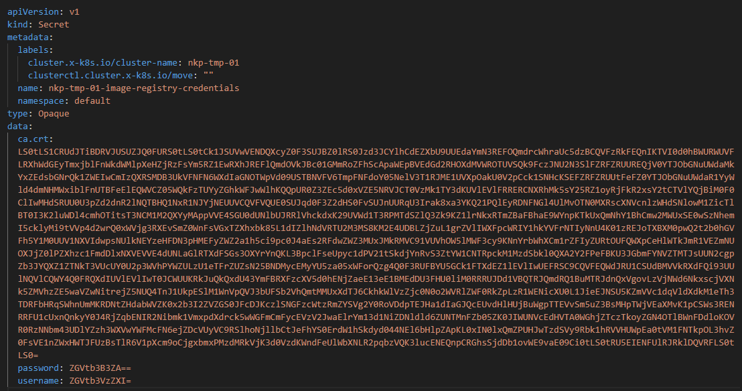
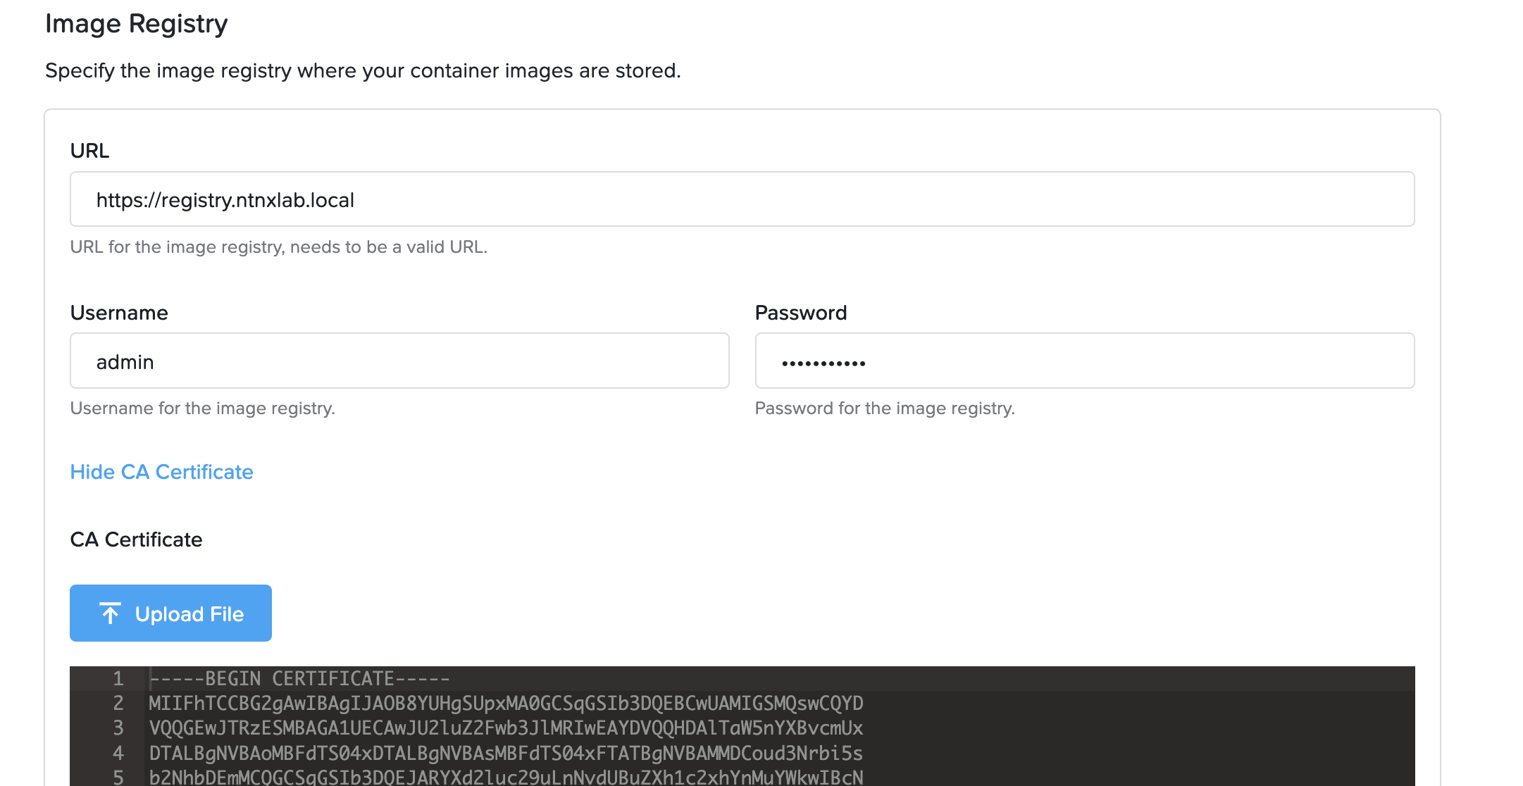
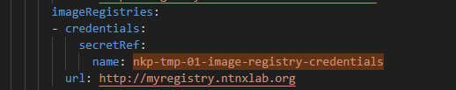
Authenticating NKP to a Registry
Initial Setup
Day-2 change
Provide info during cluster provisioning through CLI/TUI parameters
Make sure you specify the URL, not only the FQDN!
Store your registry info in a new secret (in the good workspace namespace)
Update your `cluster` resource to change user account and/or certificate secret reference
Nodes need to be recreated to use the new parameters
Notes:
describe in this slide how you can add registry at deployment time (like mentioned in step 1) (necessary if you have separate sources for CA or already existing CA/Certs), also mention that you optional can use a cert on harbor which is signed by same CA like used already for NKP ingress.

Slide 62

Proxy customization

Slide 63
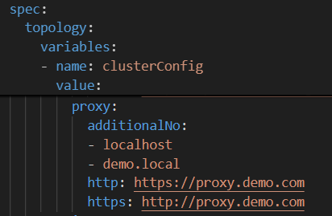
Define proxies
During cluster install, you can specify proxies.
This config will be stored in the `cluster` resources like this :

Slide 64
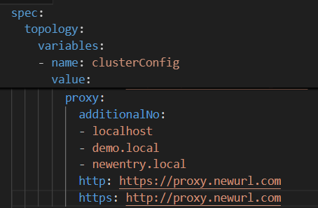
Update proxies
Update cluster resource on the management cluster
Configmap `gatekeeper-overrides` may have to be updated
Nodes need to be recreated to use the new parameters

Slide 65

Improve observability

Slide 66



Built-in K8s Metrics Monitoring
Flexibility of choice with Grafana
Use NKP OOTB dashboards, create custom dashboards or import community-driven dashboards
Prometheus Centralized Metrics
Provides OOTB cluster-wide visibility into node health, resource usage, app performance, and custom targets
Centralized Alerting with Alertmanager
Aggregates alerts across clusters with predefined and custom rules, flexible filtering, and integrations with multiple notification channels
CNCF
Projects
Nutanix Cloud Platform
NKP Management Cluster
Centralized Monitoring stack
Observability dashboards
Prometheus
Thanos
Query datasource
Grafana
Pull metrics
On-premises
Public Cloud
Edge
NKP Managed Cluster
NKP Managed Cluster
NKP Managed Cluster
Monitoring stack
Monitoring stack
Monitoring stack
Prometheus
Thanos
Prometheus
Thanos
Prometheus
Thanos
Pull metrics
Pull metrics
Pull metrics
K8s components
App
K8s components
App
K8s components
App
Notes:
Organizations require observability of their platform. This includes what applications are running, how they are running, and making sure that the right people can access this information at the right time. There are many commercial platforms organizations can choose from such as:
Splunk
Data Dog
New Relic
Dynatrace
Elastic
Commercial platforms usually charge by the amount of data ingested. Once a platform for observability is chosen the hard work begins. Teams must integrate the new tool into their stack and create the proper dashboards that are relevant to their business. In most organizations, this can take months to accomplish. Every time a new application is put into production, the process to integrate observability starts over again. New dashboards need to be created and put into place prior to an application moving to production.
NKP ships with 27 built in dashboards to help overcome these challenges and move to production faster.
It is not enough to just run a script off of Github and hope for the best. NKP not only installs and integrates Grafana into the platform, we ensure that the security configuration is correct and all critical and high CVE vulnerabilities are remediated. When we release a new platform upgrade, the platform applications are upgraded when necessary and they maintain their configuration and any needed security patches. Note that the Global 2000 and Public Sector must spend significant time on security prior to production
What do you get? A centralized management plane enables you to visualize, monitor, and manage clusters across distributed multi-cloud, and hybrid cloud environments from a single point. Observability also includes user visualizations within three types of tenancy views for global admin, business units and developers.
---
Flexibility of Choice with Grafana
Apart from pre-configured dashboards, Grafana allows you to create custom dashboards for specific monitoring requirements and preferences. You can also import community-driven dashboards. This means you can leverage a vast library of shared dashboards created by the Grafana community, saving time and benefiting from best practices and innovations developed by others.
Enhanced troubleshooting
Connect to a variety of non-Nutanix data sources allowing you to pull in metrics from different systems and services. This holistic approach facilitates faster troubleshooting by enabling you to see the bigger picture and identify relationships between different performance indicators.
Centralized access control and authentication
Grafana provides centralized access control, allowing platform teams to secure and govern metrics dashboards effectively. You can define user roles and permissions to ensure that sensitive information is only accessible to authorized personnel
---
ONLY IF CUSTOMER ASK
License tier:
NKP: Pro/Ultimate
---

Slide 67

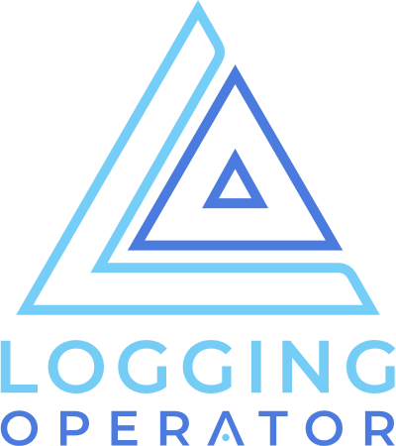

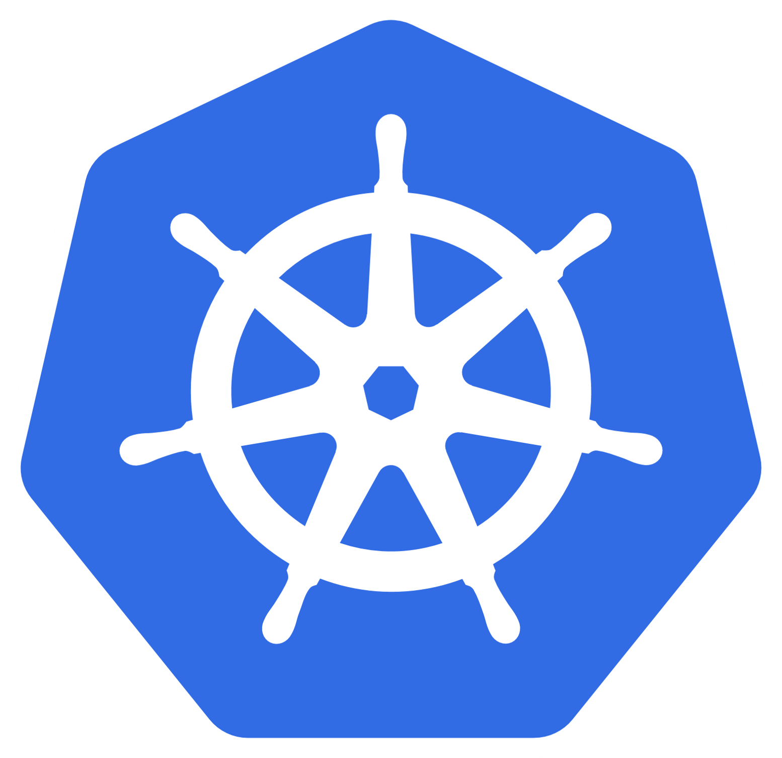

Built-in K8s Logging
CNCF
Projects
Loki
Logging Operator
Fluent Bit
Pre-configured logging stack
Collect and visualize application, infrastructure and audit logs
Real-time logging with advanced filtering and additional contextual awareness
Support for multi-tenancy. Enforce RBAC at a namespace level for more granular log access
Offload logging stack storage to external S3 buckets such as Nutanix Objects
NKP Cluster
NKP Cluster
Grafana
Analysis and Visualization
Logging
Stack
Grafana
K8s Cluster
Admin
Loki
Log aggregation
Loki
Logging Operator
Logging Operator
App
Node
App
Node
Project Namespace
K8s Namespace
K8s Namespace
Logging Operator
Loki
Grafana
Self-Service
Users
K8s Namespace
Logging Operator
Loki
Grafana
Notes:
Let’s look at the logging capabilities of our platform, which includes a pre-configured logging stack to help you manage application, infrastructure, and audit logs efficiently across your Kubernetes clusters.
Real-Time Logging
Our logging stack is built using Grafana Loki, Fluent bit and the Logging Operator, and it's installed in each Kubernetes cluster. This setup allows for seamless integration and ensures that logging is consistent and reliable across all environments. The built-in Grafana Loki dashboards provide real-time log collection and visualization with advanced filtering and parsing capabilities. You can spot patterns and correlations across multiple log lines around a log entry, giving you a more comprehensive understanding of the situation.
Support for multi-tenancy
The logging stack is built with multi-tenancy in mind, offering granular access control tailored to different user roles. The NKP Global Admin has visibility into logs from all NKP clusters across any workspace, while Workspace Admins can view logs only from clusters (and clusters) within their specific workspace (highly valuable for MSP’s supporting multiple tenants). Additionally, each Project namespace can be equipped with its own Logging Operator, which collects and routes pod logs to a dedicated Loki server assigned to that namespace. This structure keeps logs isolated at the Project level, enhancing data privacy and security. It ensures that developers or users with namespace-limited access can only view logs pertinent to their own namespace, providing a more secure and streamlined log management experience.
Storage Offloading
The logging stack supports offloading log storage to external S3 buckets, such as Nutanix Objects. This capability allows for efficient log management by freeing up cluster resources and providing scalable and cost-effective storage for long-term log retention.
---
ONLY IF CUSTOMER ASK
License tier:
Workspace logging: NKP Pro/Ultimate
Centralized Grafana and Multitenant logging: NKP Ultimate
---

Slide 68
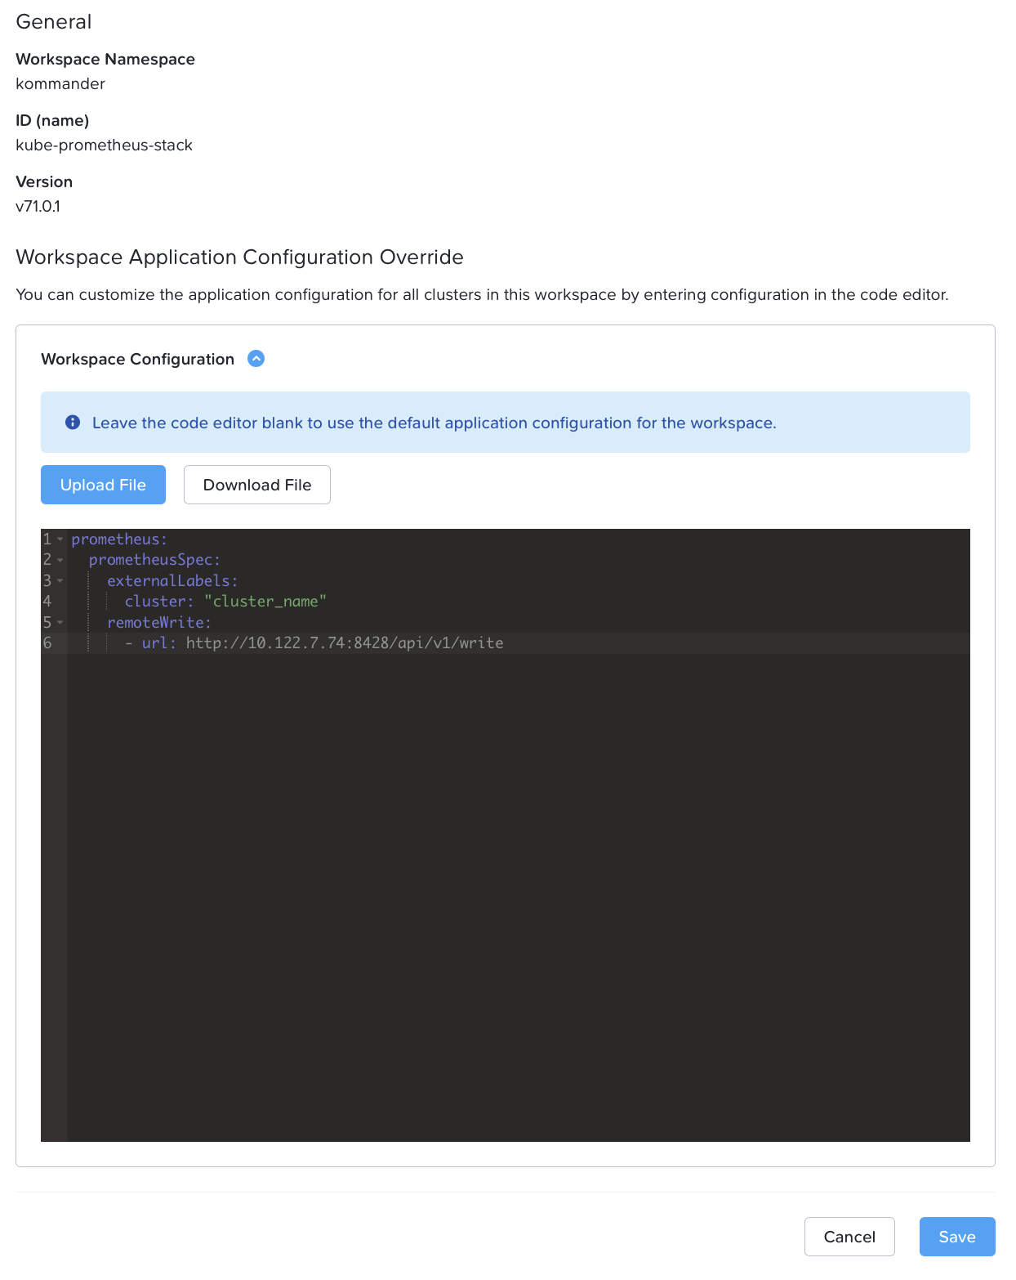
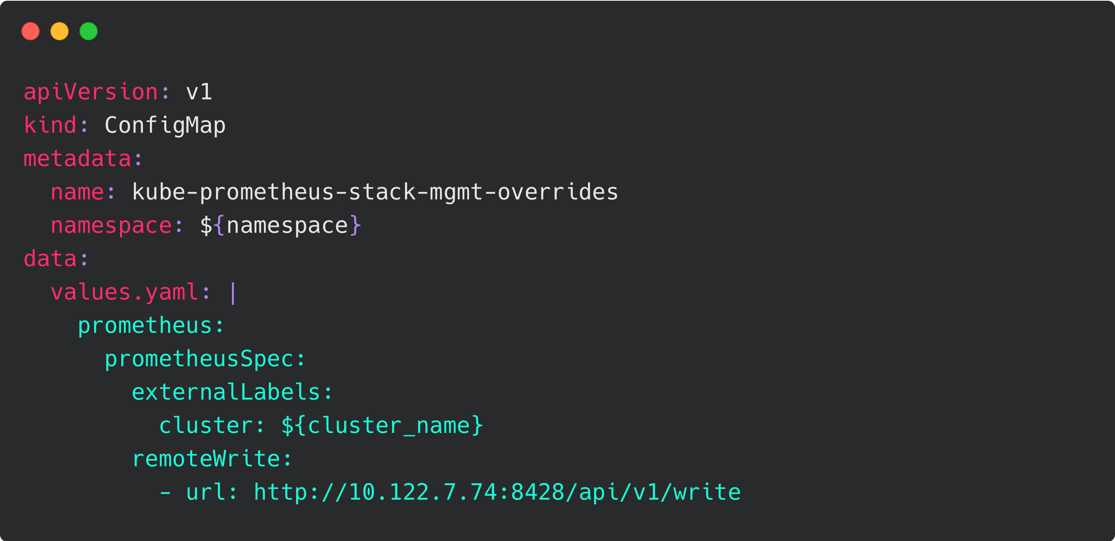
Centralized Metrics Across Clusters
Why: Centralize observability across multiple clusters
Benefits:
Unified long-term metrics storage
Global dashboards & correlation
Simplified capacity planning & troubleshooting
Method:
Use Prometheus Remote Write to push metrics to external systems (VictoriaMetrics, …)

Slide 69

Centralized Logs Across Clusters
Why: Centralize log analysis & compliance archiving
Benefits:
Unified search across clusters
Retention & compliance control
Easier debugging across environments
Method:
Configure Logging Operator to forward logs to remote storage (VictoriaLogs, …)

Slide 70

Credentials management
Notes:
Default ssh user / how to change it
Fix PC user change
Use external secret manager infisical/vault
External-secret-operator default in 2.16

Slide 71


Connect on k8s nodes
SSH account configured at install time by TUI, CLI or advanced
Need to be updated in Cluster resource
Force refresh nodes to apply the modification
SSH alternative with kubectl debug

Slide 72

Nutanix credentials lifecycle
Prism Central Credential widely used:
CAPX (mgmt cluster only)
CCM
CSI
Lock PC account if too many failed retries
Update following documentation
Manual update
Apply to each clusters
Notes:
https://portal.nutanix.com/page/documents/details?targetId=Nutanix-Kubernetes-Platform:top-update-pc-credentials-on-deployed-nkp-clusters-t.html

Slide 73


External secret management
New 2.16
ESO integrated in NKP 2.16
Management cluster only (will evolve later)
Usage
Multi-cluster secret propagation (registry for now)
Extended use cases
Centralized, secure secret management
Avoid hardcoding secrets in manifests
Integrate easily with CI/CD pipelines
Retrieve external secrets from Cloud
Manage dynamically any kind of secrets: credentials, keys, cert, token
Example Secret Backends
Infisical
HashiCorp Vault
Cloud Secret Manager (Azure, Google, AWS, …)

Slide 74
Sizing Guidance

Slide 75

Not an easy task !
How many workers I need, and how big they will be ?
It depends…
Notes:
Faire ici un slide en mode lexique, pour expliquer les terminologies.
En profiter pour bien faire le distingo entre master / workers qui sont des terminologies k8s et non NKP

Slide 76


Reminder : Resources requests and limits
Why do I carry almost empty boxes ?
Resources requests :
Resources reserved for your pods
Be careful with overbooking !
Resources limits :
Authorized resources for your pod
When it is reached :
CPU : throttling
RAM : « Hastala vista Baby »
Crashloopback OOM killed

Slide 77

K8s sizing : not only a workload consideration
Customer workloads
Customer workloads
Node OS
Customer workloads
K8s core
Customer workloads
K8s tooling
Global Kubernetes node load
Notes:
Les worklaods des clients sont une chose, mais il ne faut pas oublier l’outillage autour, k8s core, et l’OS

Slide 78

Workloads load
Should be the easiest part of the sizing
But your customer will always often struggle to define this load
Ideally, which inputs do you need ?
Resources requests / min consumption
Resources limits / max consumption
Number of pods / instance
Expected growth
Temporary scale / spike ?
Tell me about your workload needs...
Notes:
Comment collecter les besoins clients

Slide 79


Tooling load
Define which tools will be used
For each of them
Look at the doc
Check the load metric (per pode, node, cluster)
Get values
Which ones I am going to use ?
Example ISTIO docs
Notes:
Quels outils vont être utilisés, en faire l’inventaire, et regarder les charges que cela va impliquer.
Attention, peut être un cout global, ou cout par noeud, etc..

Slide 80


K8s core load
If I mix Green and Yellow with a finger of blue…
Control plane (apiserver, etcd, scheduler, …)
Vary with node numbers
Vary with number of resources (pods, srv, …)
Vary with number of API calls
NKP doc as starting point (minimum prerequistes)
Workers (kubelet, kube-proxy, CNI …)
Average 1 Core / 500MB Ram
Notes:
La charge imposée par k8s, et comment elle est impactée par la taille du cluster

Slide 81



OS load
Ubuntu
Consider a resources consumption of :
1 GHz of CPU
1 GB of RAM
20 GB of Disk
Rocky
SUSE

Slide 82

How to size ?
No secret
Get all the available inputs
Create a spreadsheet to easily test multiple scenarios
Do not forget to have free resources available, “in case of”
If your customer already uses Kubernetes, use existing metrics as the basis for your sizing.
Notes:
Introduire la notion de request/limit

Slide 83
Best worker size / Consolidation rate
Less bigs workers | More smalls workers
Bigger impact when a failure appears May cause resource wasting Reduce OS / daemonsets overhead Less nodes to manage for the control plane | Less impact after a node failure Best consumption of worker resources More OS/deamonsets overhead Higher load for control plane
If you deploy your kubernetes cluster in virtual machines, which is the ratio vCPU/core to use ?
Again, no predefined (and easy) answers
Are you confident with resources requests ? Use 1:1
You know resources requests will be overestimated ? Use x:1
https://learnkube.com/kubernetes-node-size

Slide 84

Monitoring is mandatory
You only did an estimation
Short term: You need to absolutely check if everything runs as expected
Long term: You need to constantly verify that your infrastructure provides enough resources for your apps
You have tools to help you :
Prometheus & Grafana for Kubernetes insights
Nutanix Capacity Planning for infrastructure insights

Slide 85

Nutanix experience

Slide 86

Internal Scale test scenarios
Multi clusters: Horizontal scaling
Identify product limits by creating as much NKP clusters as possible
Many workers: Vertical scaling
Identify product limits with a single cluster and as many workers as possible

Slide 87
Multi clusters: most important scale issues
Nutanix max supported (75)
100
Management cluster sizing
Nb of clusters
Maximum tested 100 clusters
700 nodes
65
30
Lack of physical resources
Resource configuration of management components (CAPI controller, infra tools, …)

Slide 88

Control Plane issue start here
Notes:
Control plane issue start at 65-70 nodes

Slide 89
Multi clusters: key takeaway
Management cluster sizing is key
Control plane node size (CPU / RAM)
Management controllers resources (requests / limits)

Slide 90
Many workers: most important scale issues
Nutanix max supported (200)
1200
Resource configuration of infra components (Gatekeeper, Prometheus, …)
1000
Maximum tested 1 cluster
1200 nodes
Nb of nodes
Prometheus stop monitoring new nodes
380
256
Lack of physical resources
CNI configuration

Slide 91

Prometheus issue start here
Notes:
The components issue starts at 380 nodes, prometheus example

Slide 92

Notes:
Prometheus operator limit

Slide 93
Many workers: key takeaway
The CNI network configuration needs to be adapted to go over 256 nodes
The configuration of infrastructure components must adapt based on cluster size, potentially utilizing vertical pod autoscalers
Once we go after 1000 nodes, we begin to reach some limits of Kubernetes architecture, and more significant changes become necessary.

Slide 94

Thank you !

